Slide 1
Web App Development with ASP.NET

Slide 2
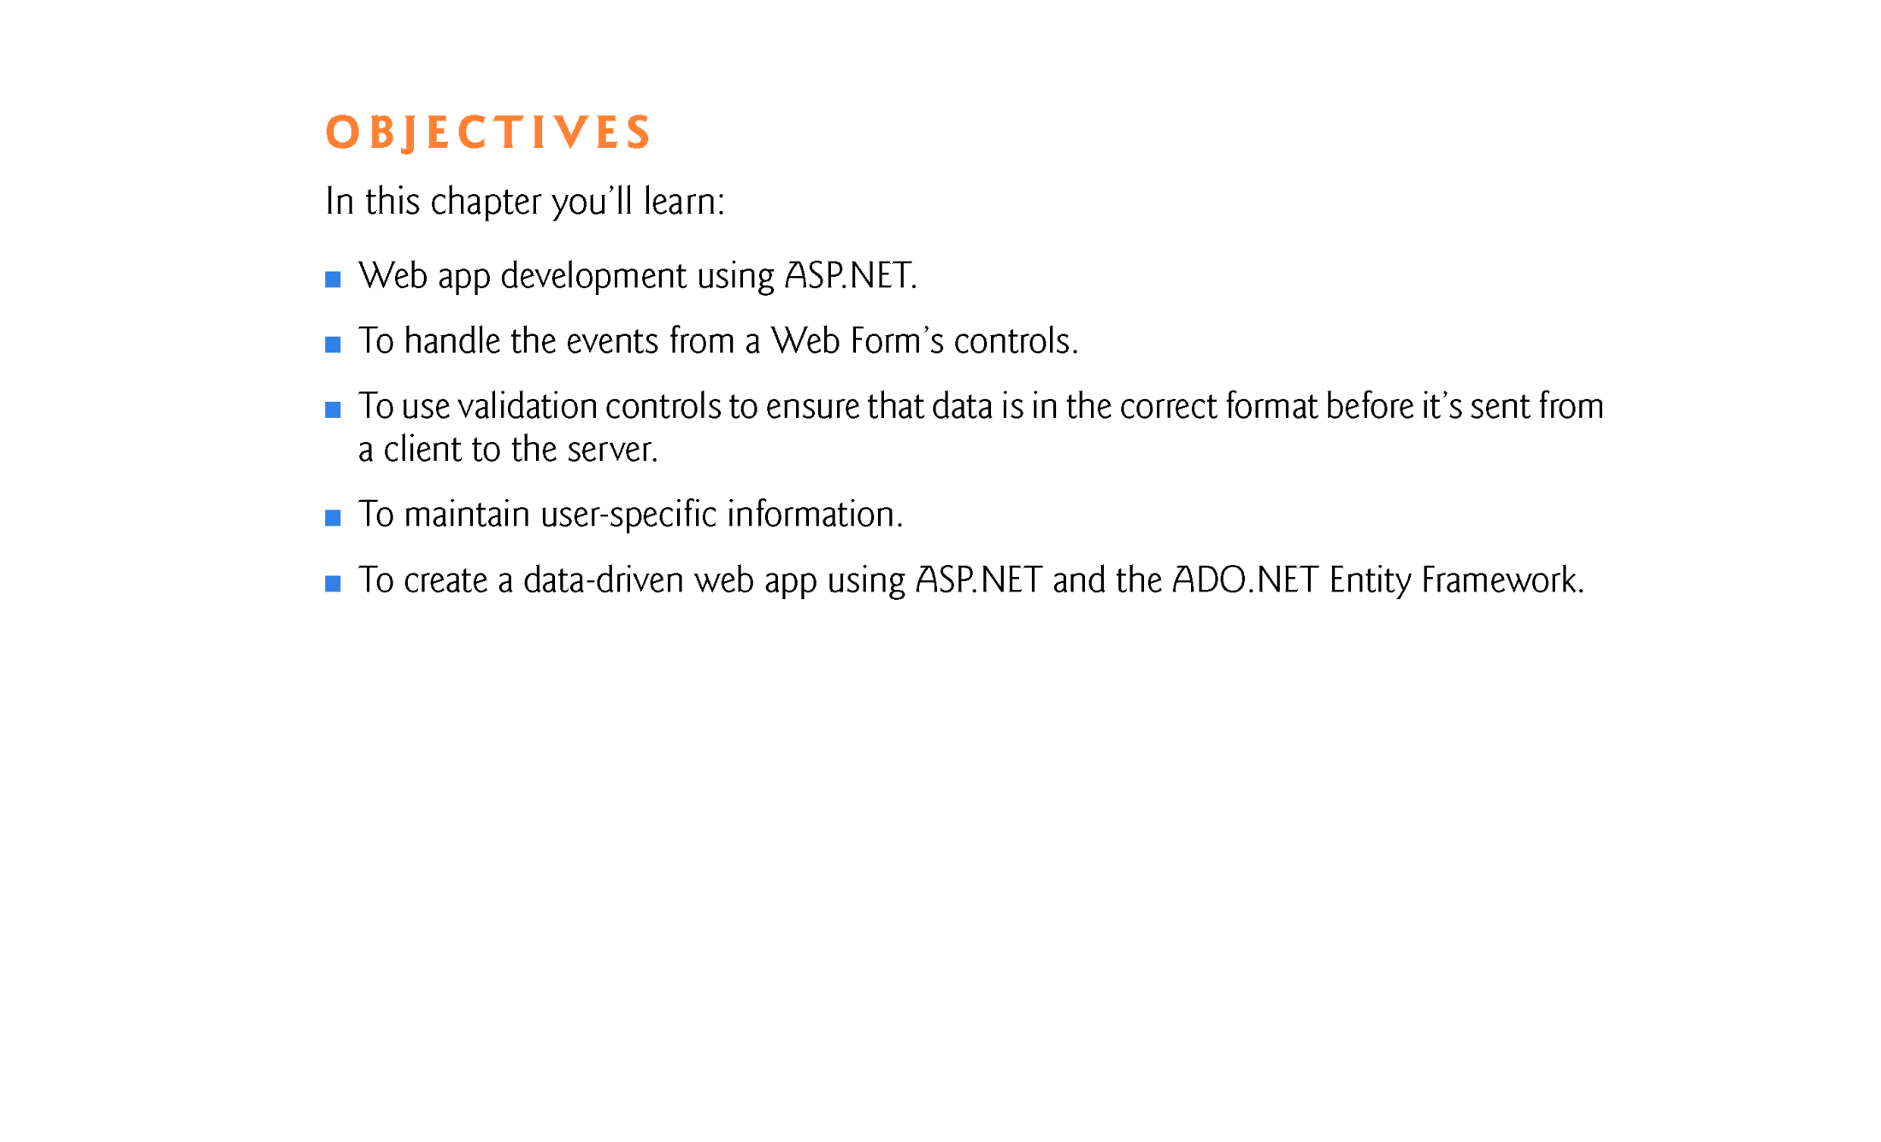

Slide 3
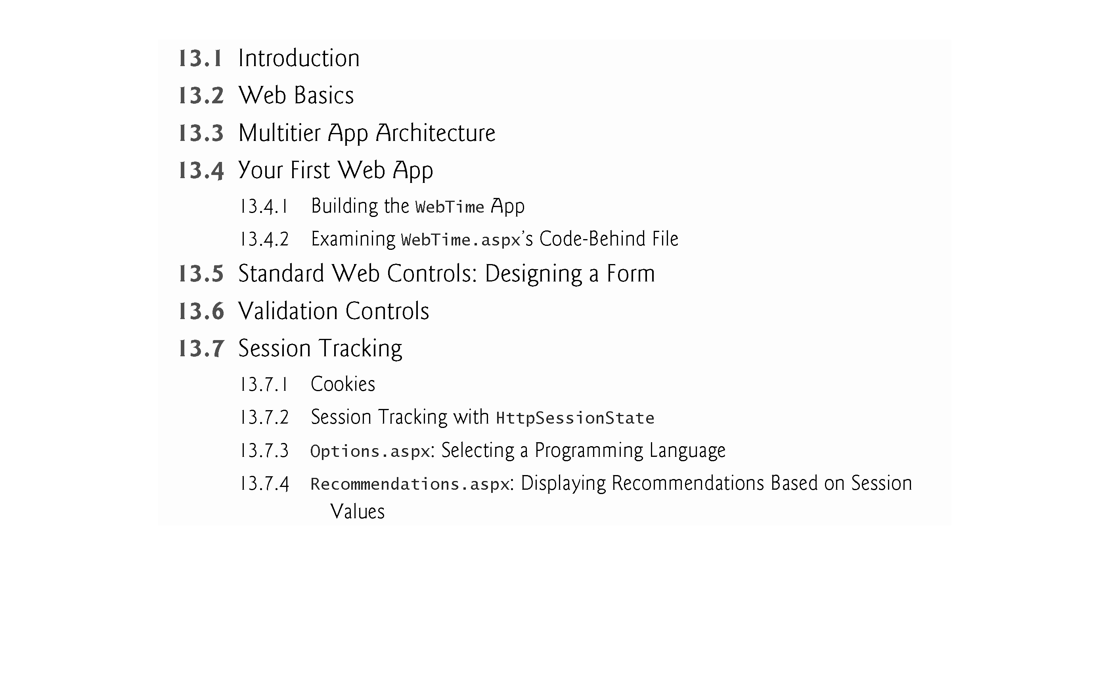

Slide 4
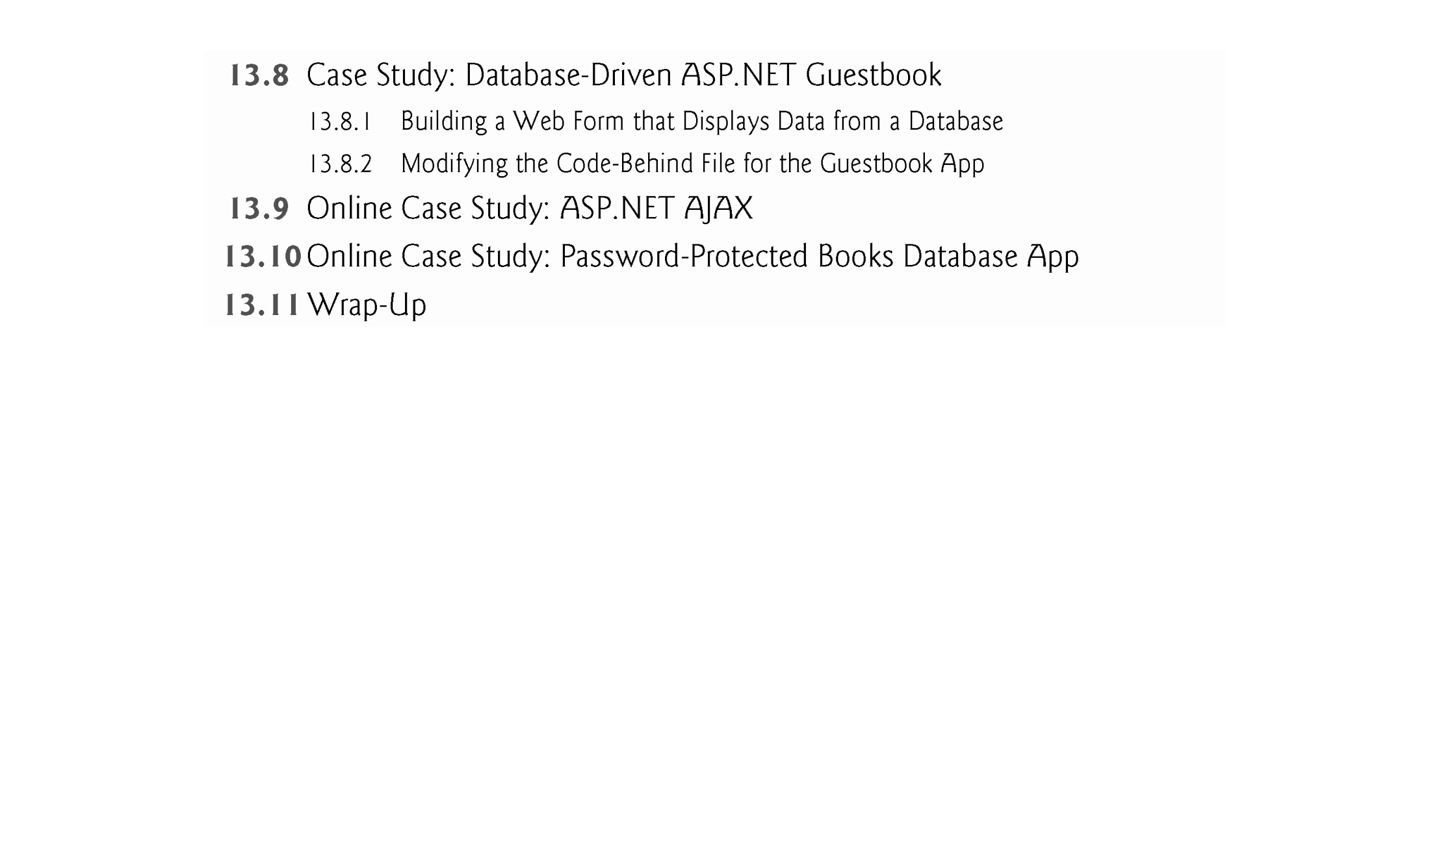

Slide 5
13.1 Introduction
In this chapter, we introduce web-app development with Microsoft’s ASP.NET technology.
Web-based apps create web content for web-browser clients.
We present several examples that demonstrate web-app development using Web Forms, web controls (also called ASP.NET server controls) and Visual Basic programming.
Web Form files have the filename extension .aspx and contain the web page’s GUI.
You customize Web Forms by adding web controls including labels, textboxes, images, buttons and other GUI components.

Slide 6
13.1 Introduction
The Web Form file represents the web page that's sent to the client browser.
We often refer to Web Form files as ASPX files.
An ASPX file created in Visual Studio has a corresponding class written in a .NET language—we use Visual Basic in this book.
This class contains event handlers, initialization code, utility methods and other supporting code.
The file that contains this class is called the code-behind file and provides the ASPX file’s programmatic implementation.

Slide 7
13.1 Introduction
Software Used in This Chapter
To develop the code and GUIs in this chapter, we used Microsoft’s Visual Studio 2017 for Web—an IDE designed for developing ASP.NET web apps.
See the Before You Begin section that follows the Preface for additional information on downloading the software for this chapter.

Slide 8
13.1 Introduction
Online Chapter—Web App Development with ASP.NET: A Deeper Look
In the online Chapter 24, Web App Development with ASP.NET: A Deeper Look, we present several additional web-app development topics, including:
master pages to maintain a uniform look-and-feel across the pages in a web app
creating password-protected websites with registration and login capabilities
using the Web Site Administration Tool to specify which parts of a website are password protected
using ASP.NET AJAX to quickly and easily improve the user experience for your web apps, giving them responsiveness comparable to that of desktop apps.

Slide 9
13.2 Web Basics
In this section, we discuss what occurs when a user requests a web page in a browser.
In its simplest form, a web page is nothing more than an HTML (HyperText Markup Language) document (with the extension .html or .htm) that describes to a web browser the document’s content and how to format it.
HTML documents normally contain hyperlinks that link to different pages or to other parts of the same page.
When the user clicks a hyperlink, a web server locates the requested web page and sends it to the user’s web browser.

Slide 10
13.2 Web Basics
Similarly, the user can type the address of a web page into the browser’s address field and press Enter to view the specified page.

Slide 11
13.2 Web Basics (cont.)
URIs and URLs
URIs (Uniform Resource Identifiers) identify resources on the Internet.
URIs that start with http:// are called URLs (Uniform Resource Locators).
Common URLs refer to files, directories or server-side code that performs tasks such as database lookups, Internet searches and business app processing.
If you know the URL of a publicly available resource anywhere on the web, you can enter that URL into a web browser’s address field and the browser can access that resource.

Slide 12
13.2 Web Basics (cont.)
Parts of a URL
A URL contains information that directs a browser to the resource that the user wishes to access.
Web servers make such resources available to web clients.
Popular web servers include Microsoft’s Internet Information Services (IIS), Apache’s HTTP Server and Nginx.
Let’s examine the components of the URL
http://www.deitel.com/books/downloads.html
The http:// indicates that the HyperText Transfer Protocol (HTTP) should be used to obtain the resource.

Slide 13
13.2 Web Basics (cont.)
HTTP is the web protocol that enables clients and servers to communicate.
Next in the URL is the server’s fully qualified hostname (www.deitel.com)—the name of the web server computer on which the resource resides.
This computer is referred to as the host, because it houses and maintains resources.
The hostname www.deitel.com is translated into an IP (Internet Protocol) address—a numerical value that uniquely identifies the server on the Internet.

Slide 14
13.2 Web Basics (cont.)
A Domain Name System (DNS) server maintains a database of hostnames and their corresponding IP addresses, and performs the translations automatically.
The remainder of the URL (/books/downloads.html) specifies the resource’s location (/books) and name (downloads.html) on the web server.
The location could represent an actual directory on the web server’s file system.
For security reasons, however, the location is typically a virtual directory.
The web server translates the virtual directory into a real location on the server, thus hiding the resource’s true location.

Slide 15
13.2 Web Basics (cont.)
Making a Request and Receiving a Response
When given a URL, a web browser uses HTTP to retrieve the resource found at that address.
Figure 13.1 shows a web browser sending a request to a web server.
Figure 13.2 shows the web server responding to that request.

Slide 16
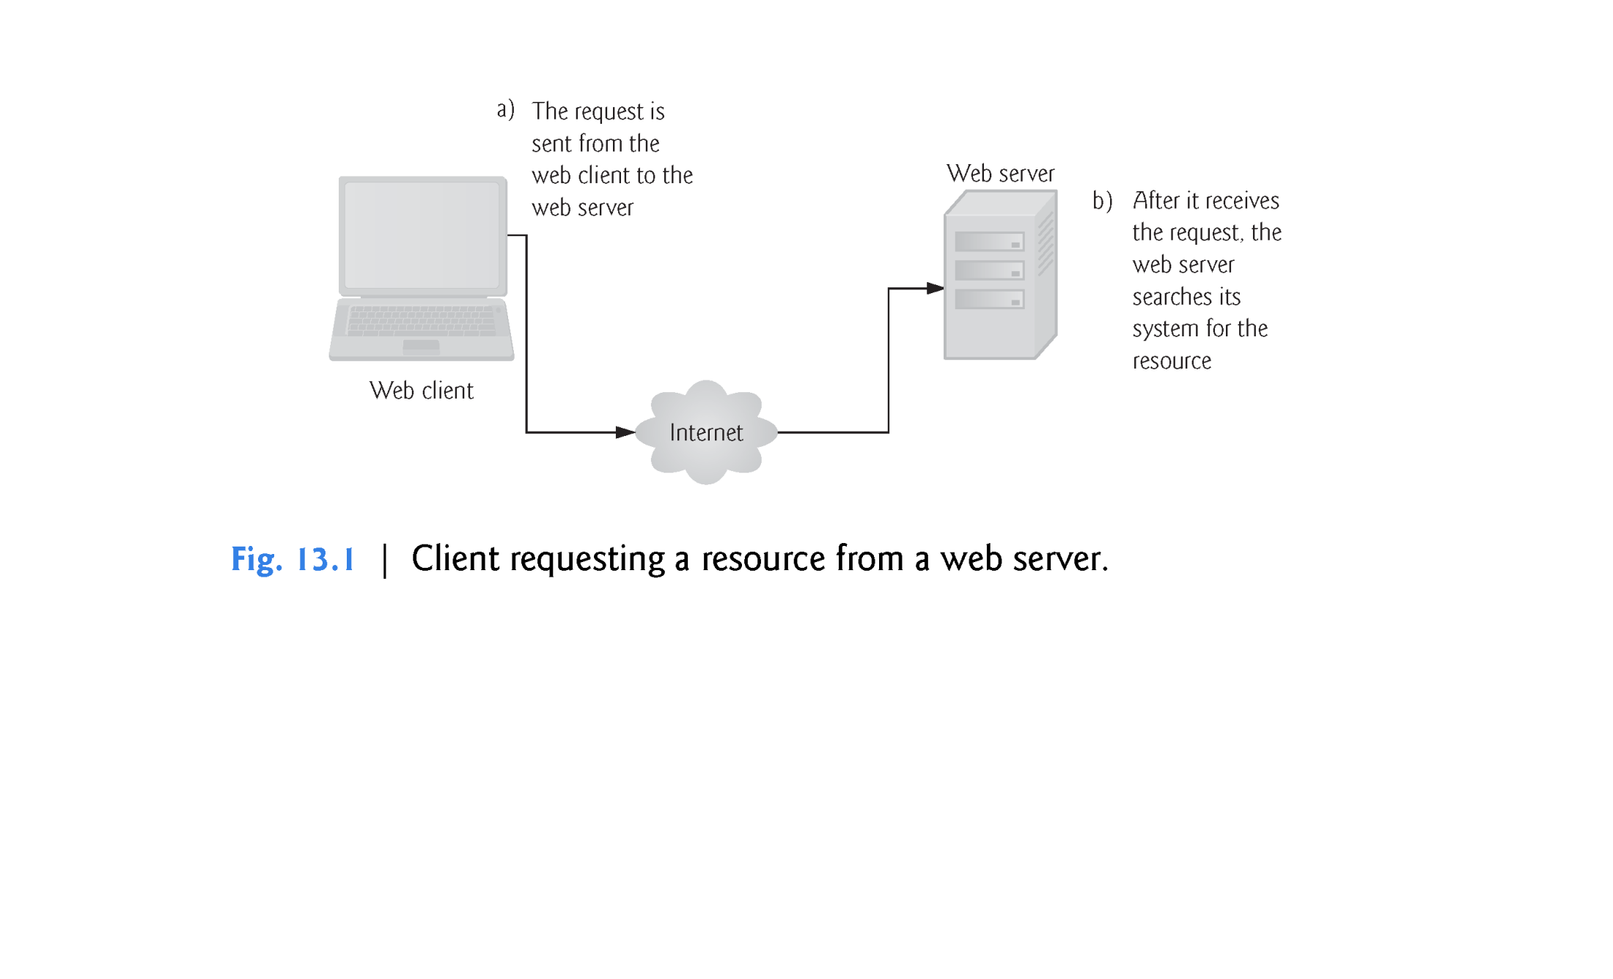

Slide 17
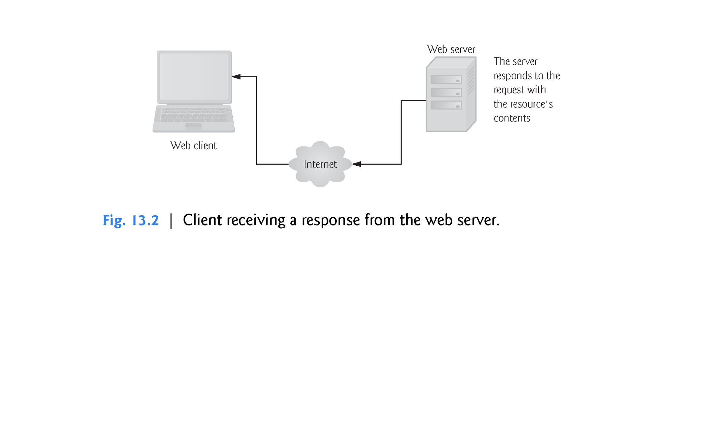

Slide 18
13.3 Multitier App Architecture
Web-based apps are multitier apps (sometimes referred to as n-tier apps).
Multitier apps divide functionality into separate tiers (that is, logical groupings of functionality).
Although tiers can be located on the same computer, the tiers of web-based apps commonly reside on separate computers for security and scalability.
Figure 13.3 presents the basic architecture of a three-tier web-based app.

Slide 19
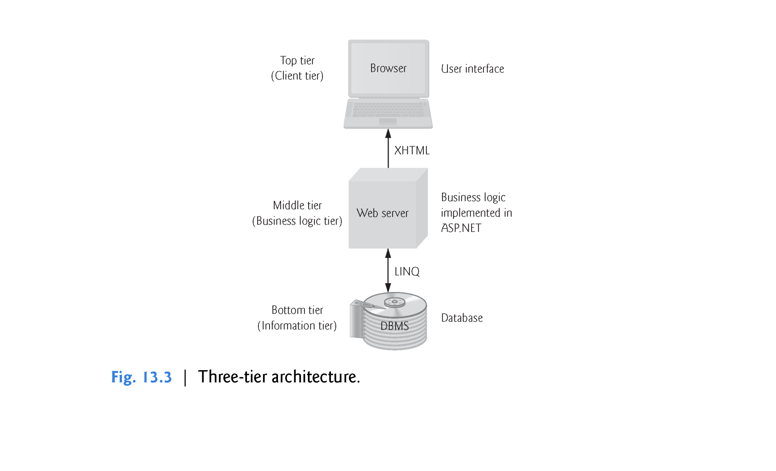

Slide 20
13.3 Multitier App Architecture (cont.)
Information Tier
The bottom tier (also called the information tier) maintains the app’s data.
This tier typically stores data in a relational database management system.
For example, a retail store might have a database for storing product information, such as descriptions, prices and quantities in stock.
The same database also might contain customer information, such as user names, billing addresses and credit card numbers.
This tier can contain multiple databases, which together comprise the data needed for an app.

Slide 21
13.3 Multitier App Architecture (cont.)
Business Logic
The middle tier implements business logic, controller logic and presentation logic to control interactions between the app’s clients and its data.
The middle tier acts as an intermediary between data in the information tier and the app’s clients.
The middle-tier controller logic processes client requests (such as requests to view a product catalog) and retrieves data from the database.
The middle-tier presentation logic then processes data from the information tier and presents the content to the client.

Slide 22
13.3 Multitier App Architecture (cont.)
Web apps present data to clients as web pages.
Business logic in the middle tier enforces business rules and ensures that data is reliable before the server app updates the database or presents the data to users.
Business rules dictate how clients can and cannot access app data, and how apps process data.
For example, a business rule in the middle tier of a retail store’s web-based app might ensure that all product quantities remain positive.
A client request to set a negative quantity in the bottom tier’s product information database would be rejected by the middle tier’s business logic.

Slide 23
13.3 Multitier App Architecture (cont.)
Client Tier
The top tier or client tier is the app’s user interface, which gathers input and displays output.
Users interact directly with the app through the user interface (typically viewed in a web browser), keyboard and mouse.
In response to user actions (for example, clicking a hyperlink), the client tier interacts with the middle tier to make requests and to retrieve data from the information tier.
The client tier then displays to the user the data retrieved from the middle tier.
The client tier never directly interacts with the information tier.

Slide 24
13.4 Your First Web App
Our first example displays the web server’s time of day in a browser window (Fig. 13.4).
When this app executes—that is, a web browser requests the app’s web page—the web server executes the app’s code, which gets the current time and displays it in a Label.
The web server then returns the result to the web browser that made the request, and the web browser renders the web page containing the time.
We executed this app in both the Internet Explorer and Firefox web browsers to show you that the web page renders identically in different browsers.

Slide 25
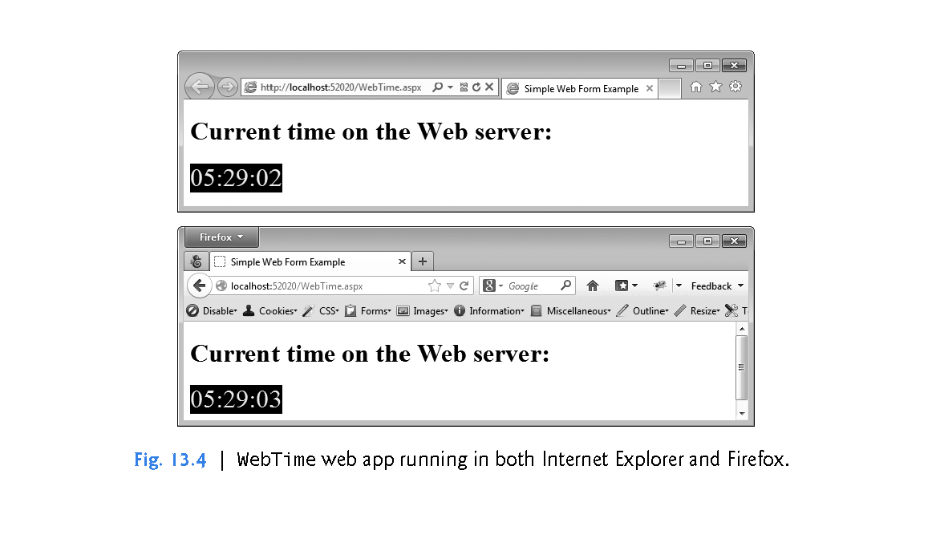

Slide 26
13.4 Your First Web App (cont.)
Testing the App in Your Default Web Browser
To test this app in your default web browser, perform the following steps:
Open Visual Studio 2017.
Select Open Web Site… from the FILE menu.
In the Open Web Site dialog (Fig. 13.5), ensure that File System is selected, then navigate to this chapter’s examples, select the WebTime folder and click the Open Button.
Select WebTime.aspx in the Solution Explorer, then type Ctrl + F5 to execute the web app.

Slide 27
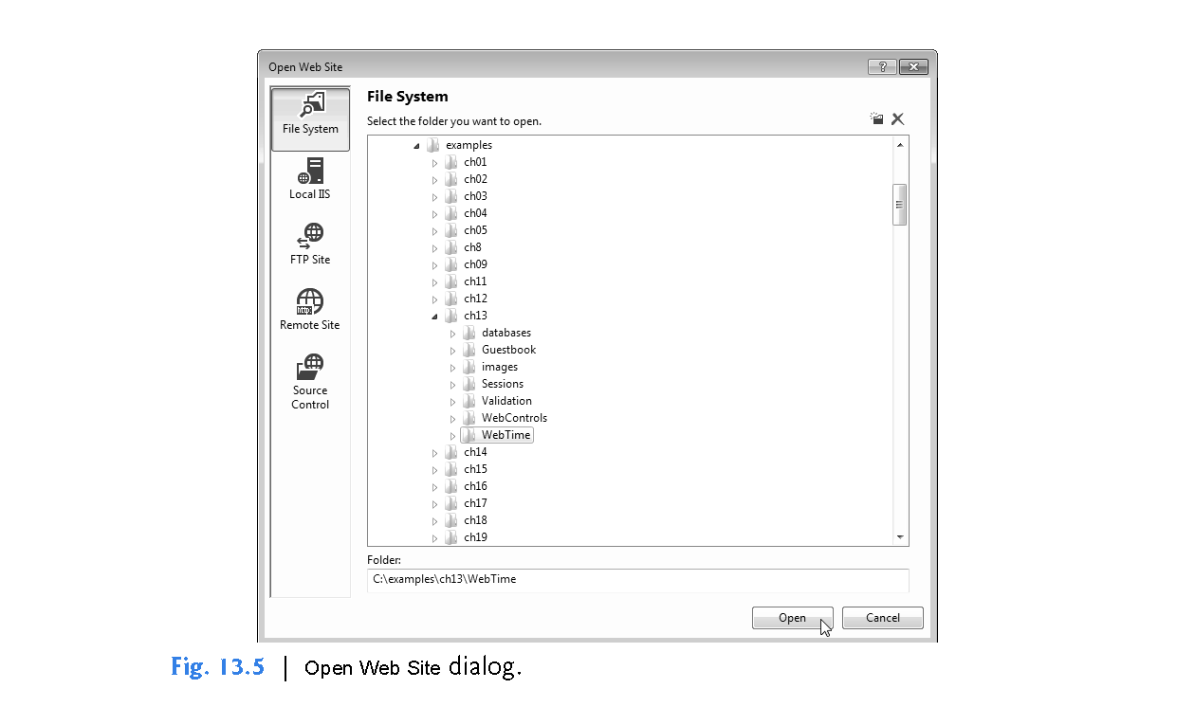

Slide 28
13.4 Your First Web App (cont.)
Testing the App in a Selected Web Browser
If you wish to execute the app in another web browser, you can copy the web page’s address from your default browser’s address field and paste it into another browser’s address field, or you can perform the following steps:
In the Solution Explorer, right click WebTime.aspx and select Browse With… to display the Browse With dialog (Fig. 13.6).
From the Browsers list, select the browser in which you’d like to test the web app and click the Browse Button.
If the browser you wish to use is not listed, you can use the Browse With dialog to add items to or remove items from the list of web browsers.

Slide 29
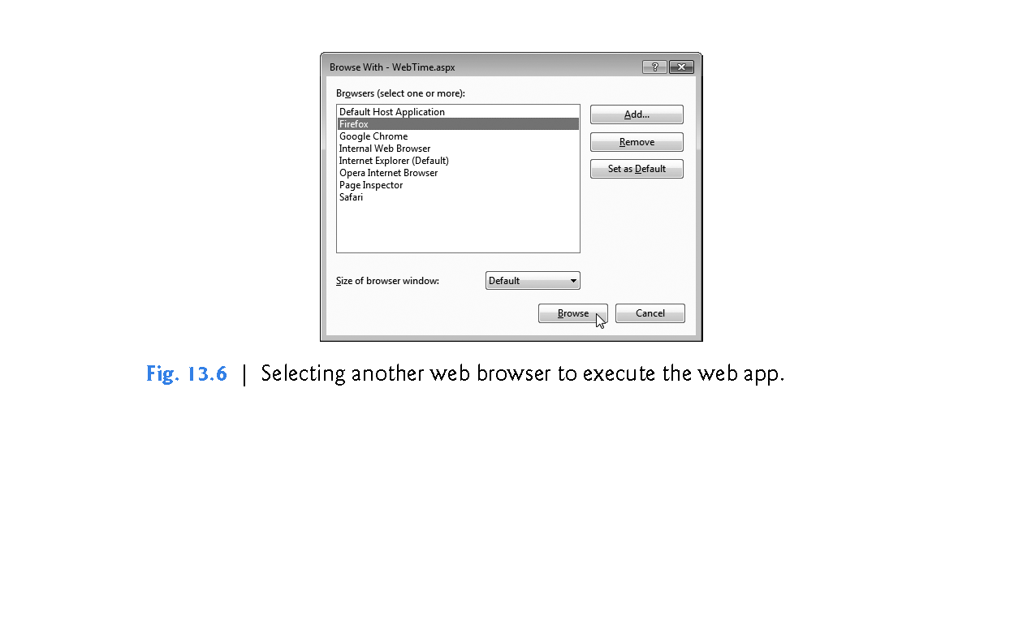

Slide 30
13.4.1 Building the WebTime App
Now that you’ve tested the app, let’s create it in Visual Studio Express for Web.
Step 1: Creating the Web Site Project
Select FILE > New Project...
to display the New Project dialog (Fig. 13.7).
In the left column of this dialog, ensure that Visual Basic is selected, then select ASP.NET Empty Web Site in the middle column.
At the bottom of the dialog you should specify the location and name of the web app, as shown in Fig. 13.7.

Slide 31
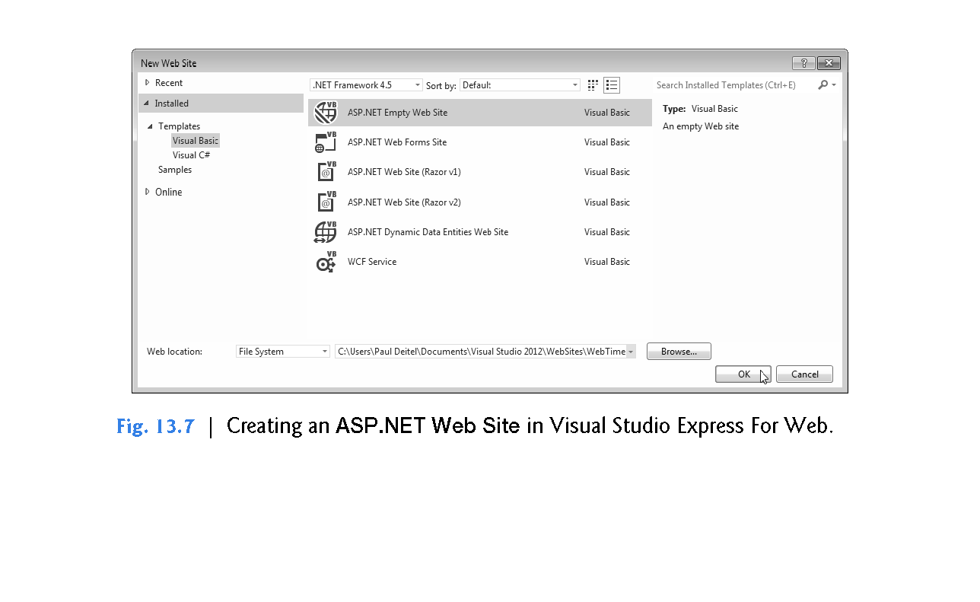
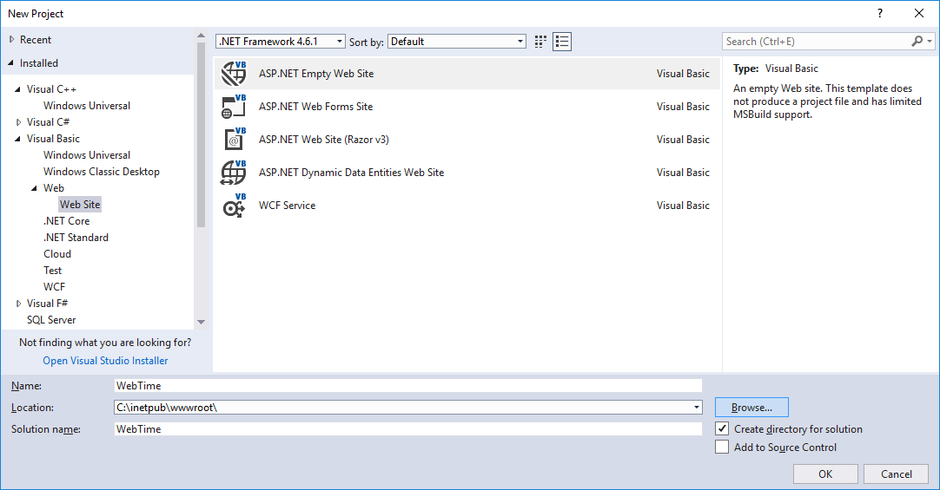

Slide 32
13.4.1 Building the WebTime App (cont.)
Step 2: Adding a Web Form to the Website and Examining the Solution Explorer
A Web Form represents one page in a web app—we’ll often use the terms “page” and “Web Form” interchangeably.
A Web Form contains a web app’s GUI.
To create the WebTime.aspx Web Form:
Right click the project name in the Solution Explorer and select Add > Add New Item... to display the Add New Item dialog (Fig. 13.8).
In the left column, ensure that Visual Basic is selected, then select Web Form in the middle column.
In the Name: TextBox, change the file name to WebTime.aspx, then click the Add Button.
After you add the Web Form, the IDE opens it in Source view by default (Fig. 13.9).
This view displays the markup for the Web Form.

Slide 33
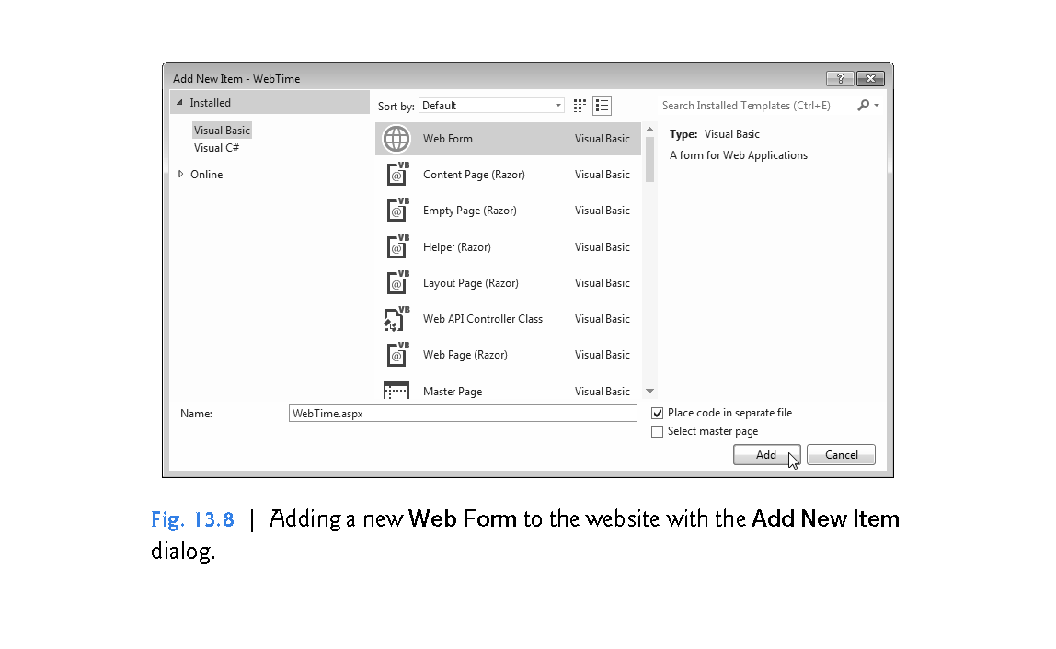

Slide 34
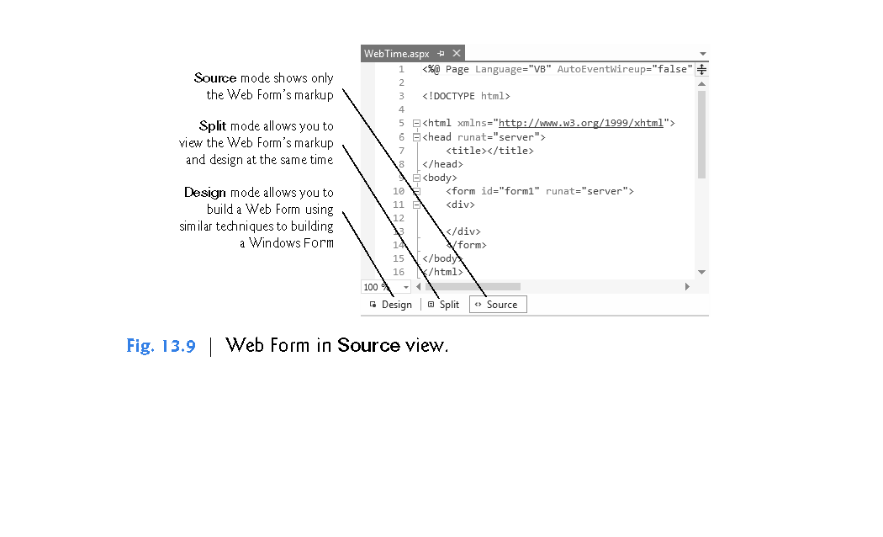

Slide 35
13.4.1 Building the WebTime App (cont.)
As you become more familiar with ASP.NET and building web sites in general, you might use Source view to perform high precision adjustments to your design (in HTML and/or CSS) or to program in the JavaScript language that executes in web browsers.
For the purposes of this chapter, we’ll keep things simple by working exclusively in Design mode.
To switch to Design mode, you can click the Design Button at the bottom of the code editor window.

Slide 36
13.4.1 Building the WebTime App (cont.)
The Solution Explorer
The Solution Explorer (Fig. 13.10) shows the contents of the website.
We expanded the node for WebTime.aspx to show you its code-behind file WebTime.aspx.vb.
Visual Studio Express For Web’s Solution Explorer contains a Nest Related Files button that organizes each Web Form and its code-behind file.

Slide 37
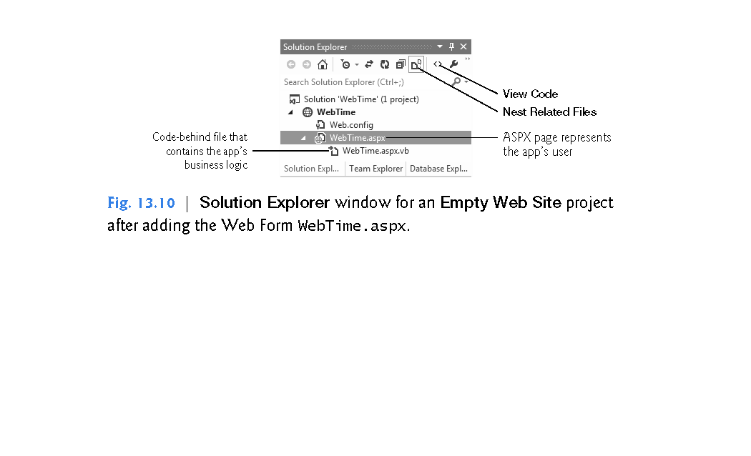

Slide 38
13.4.1 Building the WebTime App (cont.)
If the ASPX file is not open in the IDE, you can open it in Design mode by double clicking it in the Solution Explorer then selecting the Design tab, or by right clicking it in the Solution Explorer and selecting View Designer. To open the code-behind file in the code editor, you can double click it in the Solution Explorer or
select the ASPX file in the Solution Explorer, then click the View Code Button
right click the ASPX file in the Solution Explorer, then select View Code
right click the code-behind file in the Solution Explorer and select Open

Slide 39
13.4.1 Building the WebTime App (cont.)
The Toolbox
Figure 13.11 shows the Toolbox displayed in the IDE when the project loads.
Part (a) displays the beginning of the Standard list of web controls, and part (b) displays the remaining web controls and the list of other control groups.
We discuss specific controls listed in Fig. 13.11 as they’re used throughout the chapter.
Many of the controls have similar or identical names to Windows Forms controls presented earlier in the book.

Slide 40
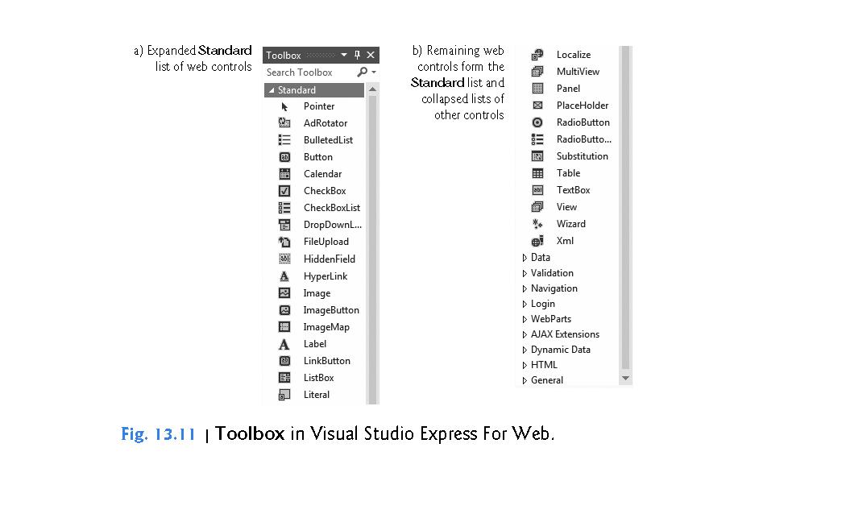

Slide 41
13.4.1 Building the WebTime App (cont.)
The Web Forms Designer
Figure 13.12 shows the initial Web Form in Design mode.
You can drag and drop controls from the Toolbox onto the Web Form.
You can also type at the current cursor location to add so-called static text to the web page.
In response to such actions, the IDE generates the appropriate markup in the ASPX file.

Slide 42
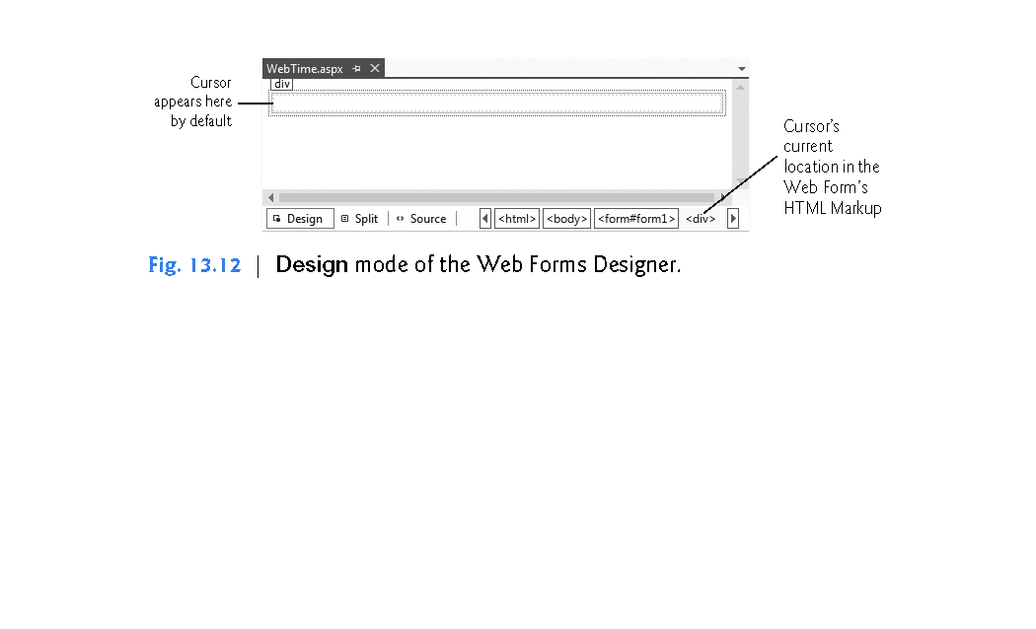

Slide 43
13.4.1 Building the WebTime App (cont.)
Step 3: Changing the Title of the Page
Before designing the Web Form’s content, you’ll change its title to Simple Web Form Example.
This title is typically displayed in the web browser’s title bar or on the browser tab that is displaying the page (see Fig. 13.4).
It’s also used by search engines like Google and Bing when they index real websites for searching.
Every page should have a title.

Slide 44
13.4.1 Building the WebTime App (cont.)
To change the title:
Ensure that the ASPX file is open in Design view.
In the Properties window’s drop-down list, view the Web Form’s properties by selecting DOCUMENT, which represents the Web Form. A web page is often called a document.
Modify the page’s Title property by setting it to Simple Web Form Example.

Slide 45
13.4.1 Building the WebTime App (cont.)
Designing a Page
Designing a Web Form is similar to designing a Windows Form.
To add controls to the page, drag-and-drop them from the Toolbox onto the Web Form in Design view.
The Web Form itself and the control’s you add to the Web Form are objects that have properties, methods and events.
You can set these properties visually using the Properties window, programmatically in the code-behind file or by editing the markup directly in the .aspx file.
You can also type text directly on a Web Form at the cursor location.

Slide 46
13.4.1 Building the WebTime App (cont.)
Controls and other elements are placed sequentially on a Web Form one after another in the order in which you drag-and-drop them onto the Web Form.
The cursor indicates the insertion point in the page.
If you want to position a control between existing text or controls, you can drop the control at a specific position between existing page elements.
You can also rearrange controls with drag-and-drop actions in Design view.

Slide 47
13.4.1 Building the WebTime App (cont.)
The positions of controls and other elements are relative to the Web Form’s upper-left corner.
This type of layout is known as relative positioning and it allows the browser to move elements and resize them based on the size of the browser window.
Relative positioning is the default, and we’ll use it throughout this chapter.
For precise control over the location and size of elements, you can use absolute positioning in which controls are located exactly where you drop them on the Web Form.

Slide 48
13.4.1 Building the WebTime App (cont.)
If you wish to use absolute positioning:
Select TOOLS > Options…., to display the Options dialog.
Expand the HTML Designer node, select the CSS Styling node and ensure that the checkbox labeled Change positioning to absolute for controls added using Toolbox, paste or drag and drop is selected.

Slide 49
13.4.1 Building the WebTime App (cont.)
Step 4: Adding Text and a Label
You’ll now add some text and a Label to the Web Form. Perform the following steps to add the text:
Ensure that the Web Form is open in Design mode.
Type the following text at the current cursor location:
Current time on the Web server:
Select the text you just typed, then select Heading 1 from the Block Format ComboBox (Fig. 13.13) in the IDE’s Formatting toolbar. This formats the text as a first-level heading that typically appears in a larger bold font. In more complex pages, headings help you specify the relative importance of parts of the content—like chapters in a book and sections in a chapter.

Slide 50
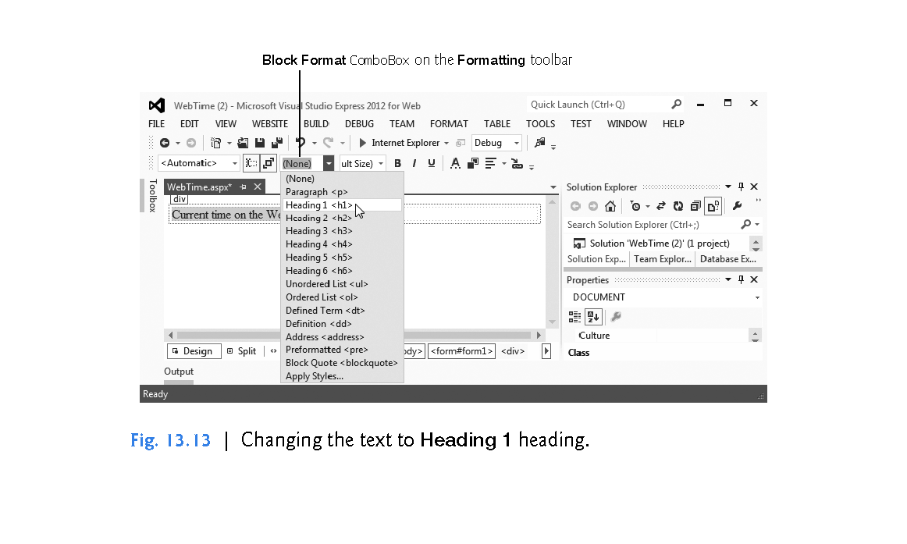

Slide 51
13.4.1 Building the WebTime App (cont.)
Click to the right of the text you just typed and press the Enter key to start a new paragraph in the page. The Web Form should now appear as in Fig. 13.14.
Next, drag a Label control from the Toolbox into the new paragraph or double click the Label control in the Toolbox to insert the Label at the current cursor position.
Using the Properties window, set the Label’s (ID) property to timeLabel. This specifies the variable name that will be used to programmatically change the Label’s Text.

Slide 52
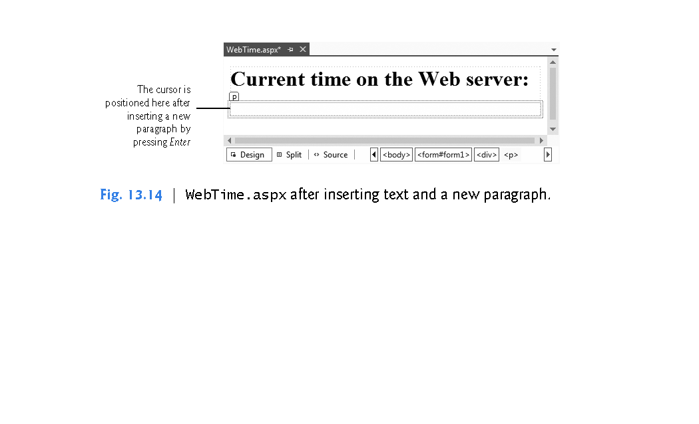

Slide 53
13.4.1 Building the WebTime App (cont.)
Because, the Label’s Text will be set programmatically, delete the current value of the Label’s Text property. When a Label does not contain text, its name is displayed in square brackets in Design view (Fig. 13.15) as a placeholder for design and layout purposes. This text is not displayed at execution time.

Slide 54
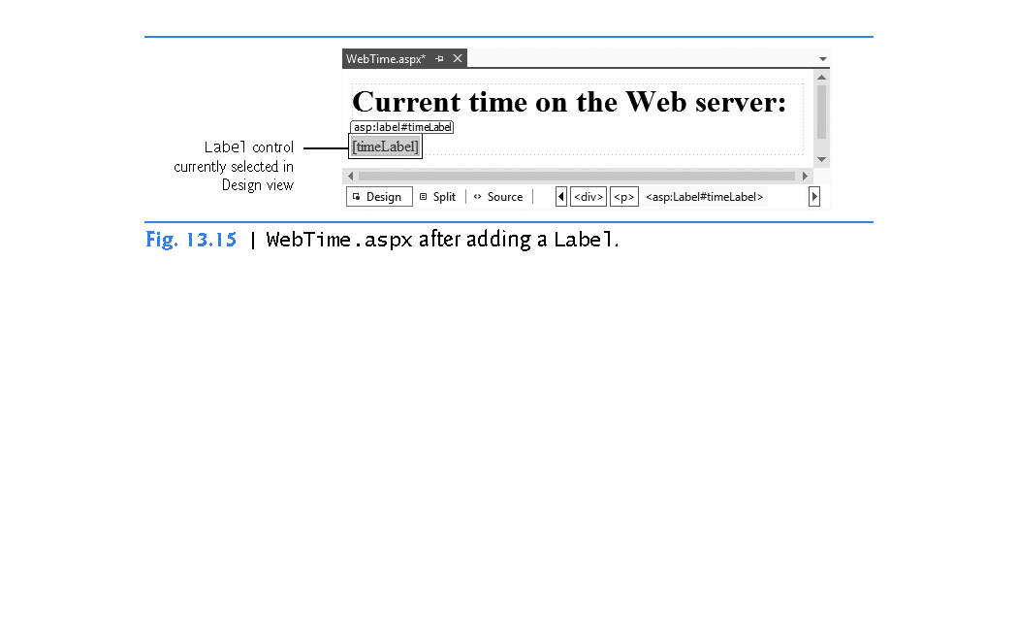

Slide 55
13.4.1 Building the WebTime App (cont.)
Step 5: Formatting the Label
Formatting in a web page is performed with CSS (Cascading Style Sheets).
The details of CSS are beyond the scope of this book.
However, it’s easy to use CSS to format text and elements in a Web Form via the tools built into Visual Studio Express for Web.
In this example, we’d like to change the Label’s background color to black, its foreground color to yellow and make its text size larger.

Slide 56
13.4.1 Building the WebTime App (cont.)
To format the Label, perform the following steps:
Click the Label in Design view to ensure that it’s selected.
Select VIEW > CSS Properties to display the CSS Properties window at the left side of the IDE (Fig. 13.16).
Right click below Applied Rules and select New Style… to display the New Style dialog (Fig. 13.17).

Slide 57
13.4.1 Building the WebTime App (cont.)
Type the new style’s name in the Selector: ComboBox—we chose .timeStyle since this will be the style used to format the time that’s displayed in the page. Styles that apply to specific elements must be named with a dot (.) preceding the name. Such a style is called a CSS class.
Each item you can set in the New Style dialog is known as a CSS attribute. To change timeLabel’s foreground color, select the Font category from the Category list, then select the yellow color swatch for the color attribute.
Next, change the font-size attribute to xx-large.

Slide 58
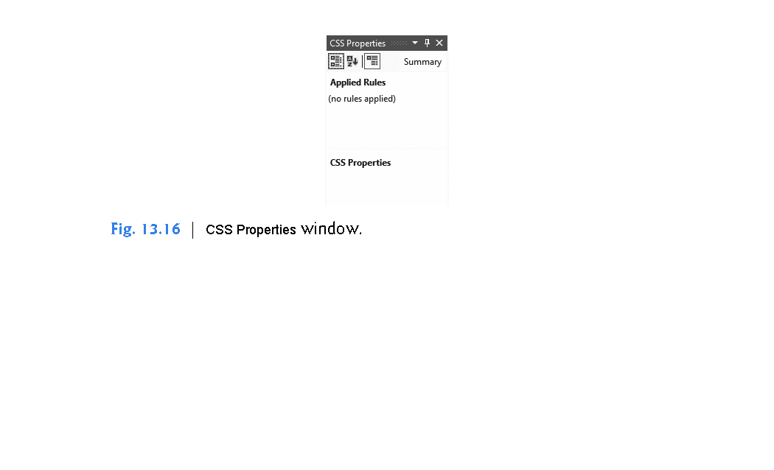

Slide 59
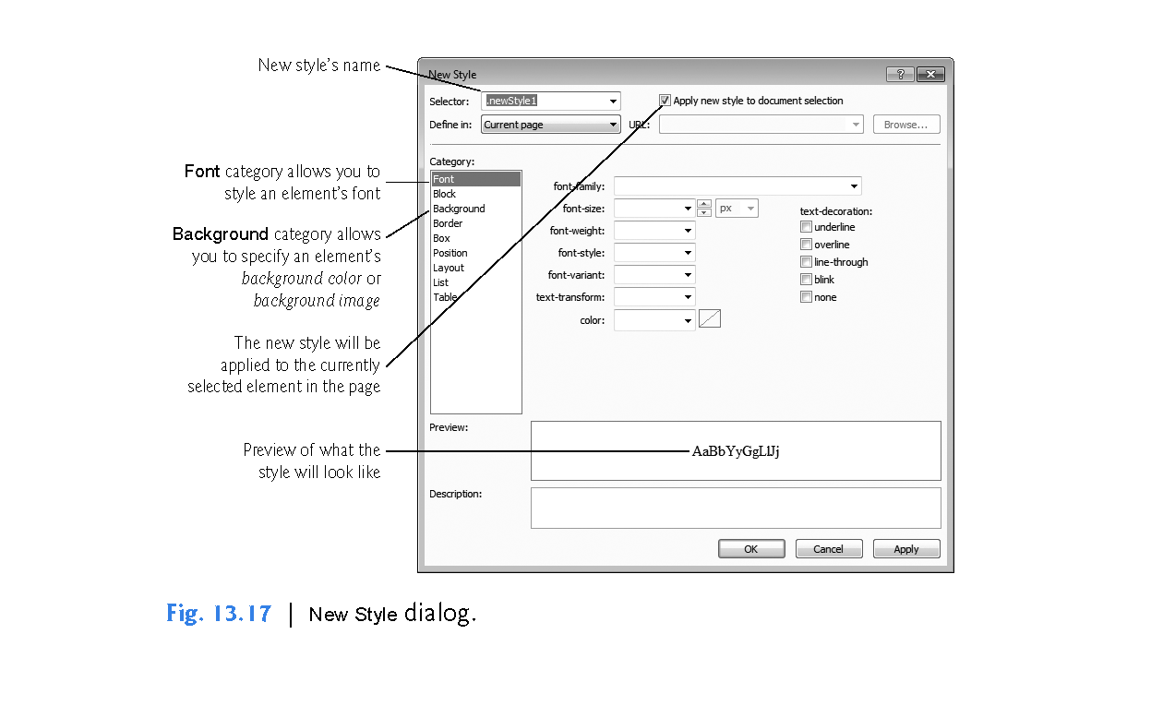

Slide 60
13.4.1 Building the WebTime App (cont.)
To change timeLabel’s background color, select the Background category, then select the black color swatch for the background-color attribute.
The New Style dialog should now appear as shown in (Fig. 13.18).
Click the OK Button to apply the style to the timeLabel so that it appears as shown in Fig. 13.19.
Also, notice that the Label’s CssClass property is now set to timeStyle in the Properties window.

Slide 61
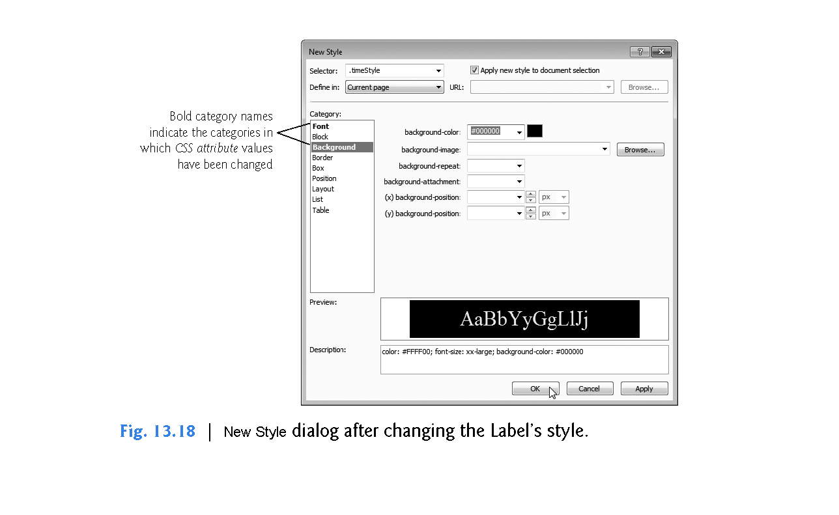

Slide 62
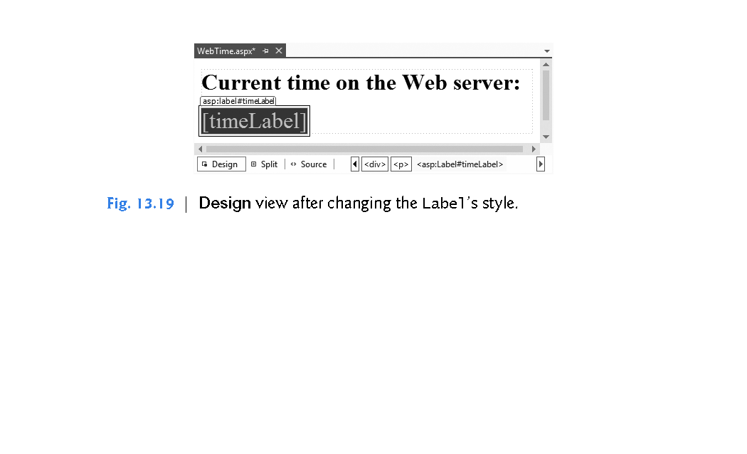

Slide 63
13.4.1 Building the WebTime App (cont.)
Step 6: Adding Page Logic
Now you’ll write code in the code-behind file to obtain the server’s time and display it on the Label.
Open WebTime.aspx.vb by double clicking it in the Solution Explorer.
In this example, you’ll add an event handler to the code-behind file to handle the Web Form’s Init event, which occurs when the page is requested by a web browser.
The event handler for this event—named Page_Init—initializes the page.
The only initialization required for this example is to set the timeLabel’s Text property to the time on the web server computer.

Slide 64
13.4.1 Building the WebTime App (cont.)
To create the Page_Init event handler:
Select (WebTime Events) from the middle ComboBox at the top of the code editor window.
Select Init from the right-most ComboBox at the top of the code editor window.
Complete the event handler by inserting the following code in the WebTime_Init event handler:
' display the server's current time in timeLabel timeLabel.Text = DateTime.Now.ToString("hh:mm:ss")

Slide 65
13.4.1 Building the WebTime App (cont.)
Step 7: Setting the Start Page and Running the Program
To ensure that WebTime.aspx loads when you execute this app, right click it in the Solution Explorer and select Set As Start Page.
You can now run the program in one of several ways.
At the beginning of Fig. 13.4, you learned how to view the Web Form by typing Ctrl + F5.
You can also right click an ASPX file in the Solution Explorer and select View in Browser.

Slide 66
13.4.1 Building the WebTime App (cont.)
Both of these techniques execute IIS Express, open your default web browser and load the page into the browser, thus running the web app.
IIS Express stops when you exit Visual Studio for Web.
If problems occur when running your app, you can run it in debug mode by selecting DEBUG > Start Debugging, by clicking the Start Debugging Button or by typing F5 to view the web page in a web browser with debugging enabled.

Slide 67
13.4.1 Building the WebTime App (cont.)
You cannot debug a web app unless debugging is explicitly enabled in the app’s Web.config file—a file that's generated when you create an ASP.NET web app.
This file stores the app’s configuration settings.
You’ll rarely need to manually modify Web.config.
The first time you select DEBUG > Start Debugging in a project, a dialog appears and asks whether you want the IDE to modify the Web.config file to enable debugging.

Slide 68
13.4.1 Building the WebTime App (cont.)
After you click OK, the IDE executes the app.
You can stop debugging by selecting DEBUG > Stop Debugging.
Regardless of how you execute the web app, the IDE will compile the project before it executes.
In fact, ASP.NET compiles your web page whenever it changes between HTTP requests.
For example, suppose you browse the page, then modify the ASPX file or add code to the code-behind file.
When you reload the page, ASP.NET recompiles the page on the server before returning the response to the browser.
This important behavior ensures that clients always see the latest version of the page.
You can manually compile an entire website by selecting Build Web Site from the DEBUG menu in Visual Studio Express for Web.

Slide 69
13.4.2 Examining WebTime.aspx’s Code-Behind File
Figure 13.20 presents the code-behind file WebTime.aspx.vb.
Line 3 begins the declaration of class WebTime.
A class declaration can span multiple source-code files—the separate portions of the class declaration in each file are known as partial classes.
The Partial modifier indicates that the code-behind file is part of a larger class.
Like Windows Forms apps, the rest of the class’s code is generated for you based on your visual interactions to create the app’s GUI in Design mode.

Slide 70
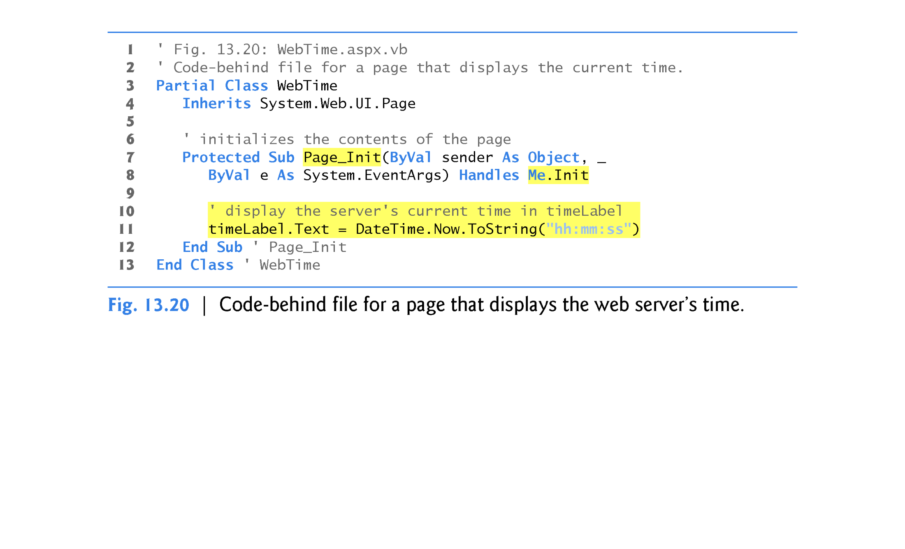

Slide 71
13.4.2 Examining WebTime.aspx’s Code-Behind File (cont.)
That code is stored in other source code files as partial classes with the same name.
The compiler assembles all the partial classes that have the same into a single class declaration.
Line 4 indicates that WebTime inherits from class Page in namespace System.Web.UI.
This namespace contains classes and controls for building web-based apps.
Class Page represents the default capabilities of each page in a web app—all pages inherit directly or indirectly from this class.

Slide 72
13.4.2 Examining WebTime.aspx’s Code-Behind File (cont.)
Lines 7–12 define the Page_Init event handler, which initializes the page in response to the page’s Init event.
The only initialization required for this page is to set the timeLabel’s Text property to the time on the web server computer.
The statement in line 11 retrieves the current time (DateTime.Now) and formats it as hh:mm:ss.
For example, 9 AM is formatted as 09:00:00, and 2:30 PM is formatted as 02:30:00.
As you’ll see, variable timeLabel represents an ASP.NET Label control.
The ASP.NET controls are defined in namespace System.Web.UI.WebControls.

Slide 73
13.5 Standard Web Controls: Designing a Form
This section introduces some of the web controls located in the Standard section of the Toolbox (Fig. 13.11).
Figure 13.21 summarizes the controls used in the next example.

Slide 74
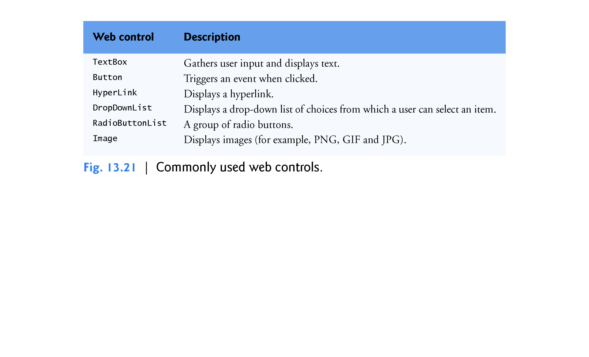

Slide 75
13.5 Standard Web Controls
A Form Gathering User Input
Figure 13.22 depicts a form for gathering user input.
This example does not perform any tasks—that is, no action occurs when the user clicks Register.
As an exercise, we ask you to provide the functionality.
Here we focus on the steps for adding these controls to a Web Form and for setting their properties.
Subsequent examples demonstrate how to handle the events of many of these controls.

Slide 76
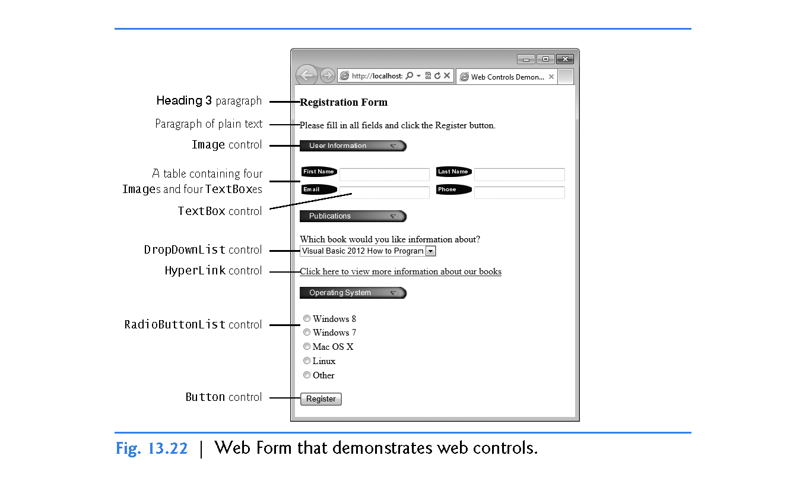

Slide 77
13.5 Standard Web Controls (cont.)
To execute this app:
Select Open Web Site… from the FILE menu.
In the Open Web Site dialog, ensure that File System is selected, then navigate to this chapter’s examples, select the WebControls folder and click the Open Button.
Select WebControls.aspx in the Solution Explorer, then type Ctrl + F5 to execute the web app in your default web browser.

Slide 78
13.5 Standard Web Controls (cont.)
Step 1: Creating the Web Site
To begin, follow the steps in Section 13.4.1 to create an Empty Web Site named WebControls, then add a Web Form named WebControls.aspx to the project.
Set the document’s Title property to "Web Controls Demonstration".
Right click WebControls.aspx in the Solution Explorer and select Set As Start Page to ensure that this page loads when you execute the app.

Slide 79
13.5 Standard Web Controls (cont.)
Step 2: Adding the Images to the Project
The images used in this example are located in the Images folder in the Lab Exercises section of my Moodle site.
Before you can display this app’s images in the Web Form, they must be download and added to your project.

Slide 80
13.5 Standard Web Controls (cont.)
To add the Images folder to your project:
Download the Images folder from Moodle onto your machine. Do this by clicking on the Images link in Moodle, then click the Edit button and then click on the Download All icon.
Locate and unzip the downloaded Images folder. Select and copy all the images in this folder.
In Visual Studio, right-click on the project (WebControls) in Solution Explorer and select Add > New Folder. Rename the folder as Images.
Right-click on this folder and paste the images you previously copied.

Slide 81
13.5 Standard Web Controls (cont.)
Step 3: Adding Text and an Image to the Form
Next, you’ll begin creating the page. Perform the following steps:
First create the page’s heading. At the current cursor position on the page, type the text "Registration Form", then use the Block Format ComboBox in the IDE’s toolbar to change the text to Heading 3 format.
Press Enter to start a new paragraph, then type the text "Please fill in all fields and click the Register button".

Slide 82
13.5 Standard Web Controls (cont.)
Press Enter to start a new paragraph, then double click the Image control in the Toolbox. This control inserts an image into a web page, at the current cursor position. Set the Image’s (ID) property to userInformationImage. The ImageUrl property specifies the location of the image to display. In the Properties window, click the ellipsis for the ImageUrl property to display the Select Image dialog. Select the Images folder to display the list of images. Then select the image user.png.
Click OK to display the image in Design view, then click to the right of the Image and press Enter to start a new paragraph.

Slide 83
13.5 Standard Web Controls (cont.)
Adding a Table to the Form
Form elements are sometimes placed in tables for layout purposes—like the elements that represent the first name, last name, e-mail and phone information in Fig. 13.22.
Next, you’ll create a table with two rows and two columns in Design mode.
Select TABLE > Insert Table to display the Insert Table dialog (Fig. 13.23). This dialog allows you to configure the table’s options.
Under Size, ensure that the values of Rows and Columns are both 2—these are the default values.
Click OK to close the Insert Table dialog and create the table.

Slide 84
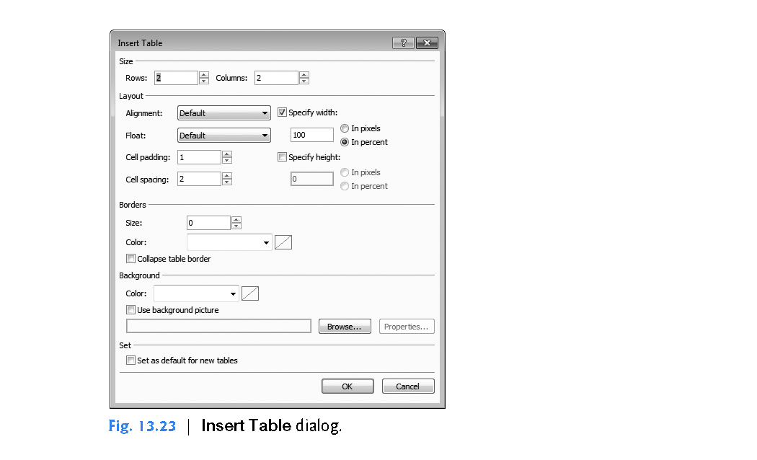

Slide 85
13.5 Standard Web Controls (cont.)
By default, the contents of a table cell are aligned vertically in the middle of the cell.
After creating the table, controls and text can be added to particular cells to create a neatly organized layout.
Next, add Image and TextBox controls to each the four table cells as follows:
Click the table cell in the first row and first column of the table, then double click the Image control in the Toolbox. Set its (ID) property to firstNameImage and set its ImageUrl property to the image fname.png.

Slide 86
13.5 Standard Web Controls (cont.)
Next, double click the TextBox control in the Toolbox. Set its (ID) property to firstNameTextBox. As in Windows Forms, a TextBox control allows you to obtain text from the user and display text to the user
Repeat this process in the first row and second column, but set the Image’s (ID) property to lastNameImage and its ImageUrl property to the image lname.png, and set the TextBox’s (ID) property to lastNameTextBox.

Slide 87
13.5 Standard Web Controls (cont.)
Repeat Steps 1 and 2 in the second row and first column, but set the Image’s (ID) property to emailImage and its ImageUrl property to the image email.png, and set the TextBox’s (ID) property to emailTextBox.
Repeat Steps 1 and 2 in the second row and second column, but set the Image’s (ID) property to phoneImage and its ImageUrl property to the image phone.png, and set the TextBox’s (ID) property to phoneTextBox.

Slide 88
13.5 Standard Web Controls (cont.)
Step 5: Creating the Publications Section of the Page
This section contains an Image, some text, a DropDownList control and a HyperLink control.
Perform the following steps to create this section:
Click below the table, then use the techniques you’ve already learned in this section to add an Image named publicationsImage that displays the publications.png image.

Slide 89
13.5 Standard Web Controls (cont.)
Click to the right of the Image, then press Enter and type the text "Which book would you like information about?" in the new paragraph.
Press Enter to create a new line in the current paragraph, then double click the DropDownList control in the Toolbox. Set its (ID) property to booksDropDownList. This control is similar to the Windows Forms ComboBox control, but doesn’t allow users to type text. When a user clicks the drop-down list, it expands and displays a list from which the user can make a selection.

Slide 90
13.5 Standard Web Controls (cont.)
You can add items to the DropDownList using the ListItem Collection Editor by clicking the ellipsis next to the DropDownList’s Items property in the Properties window, or by using the DropDownList Tasks smart-tag menu. To open this menu, click the small arrowhead that appears in the upper-right corner of the control in Design mode (Fig. 13.24). Visual Studio 2017 for Web displays smart-tag menus for many ASP.NET controls to facilitate common tasks.

Slide 91
13.5 Standard Web Controls (cont.)
Clicking Edit Items... in the DropDownList Tasks menu opens the ListItem Collection Editor, which allows you to add ListItem elements to the DropDownList. Add items for "Visual Basic 2017 How to Program", "Visual C# 2017 How to Program", "Java How to Program" and "C++ How to Program" by clicking the Add Button four times. For each item, select it, then set its Text property to one of the four book titles.

Slide 92
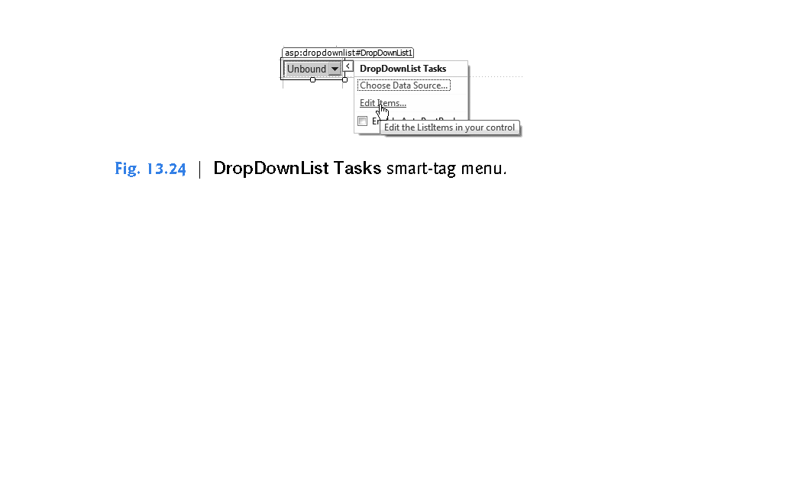

Slide 93
13.5 Standard Web Controls (cont.)
Click to the right of the DropDownList and press Enter to start a new paragraph, then double click the HyperLink control in the Toolbox to add a hyperlink to the web page. Set its (ID) property to booksHyperLink and its Text property to "Click here to view more information about our books".

Slide 94
13.5 Standard Web Controls (cont.)
Set the NavigateUrl property to http://www.deitel.com. This specifies the resource or web page that will be requested when the user clicks the HyperLink. Setting the Target property to _blank specifies that the requested web page should open in a new tab or browser window. By default, HyperLink controls cause pages to open in the same browser window.

Slide 95
13.5 Standard Web Controls (cont.)
Step 6: Completing the Page
Next you’ll create the Operating System section of the page and the Register Button.
This section contains a RadioButtonList control, which provides a series of radio buttons from which the user can select only one.
The RadioButtonList Tasks smart-tag menu provides an Edit Items… link to open the ListItem Collection Editor so that you can create the items in the list.

Slide 96
13.5 Standard Web Controls (cont.)
Perform the following steps:
Click to the right of the HyperLink control and press Enter to create a new paragraph, then add an Image named osImage that displays the os.png image.
Click to the right of the Image and press Enter to create a new paragraph, then add a RadioButtonList. Set its (ID) property to osRadioButtonList. Use the ListItem Collection Editor to add the items shown in Fig. 13.22.

Slide 97
13.5 Standard Web Controls (cont.)
Finally, click to the right of the RadioButtonList and press Enter to create a new paragraph, then add a Button. A Button web control represents a button that triggers an action when clicked. Set its (ID) property to registerButton and its Text property to Register. As stated earlier, clicking the Register button in this example does not do anything.
You can now execute the app (Ctrl + F5) to see the Web Form in your browser.

Slide 98
13.6 Validation Controls
This section introduces a different type of web control, called a validation control or validator, which determines whether the data in another web control is in the proper format.
For example, validators can determine whether a user has provided information in a required field or whether a zip-code field contains exactly five digits.
Validators provide a mechanism for validating user input on the client and the server.
When the page is sent to the client, the validator is converted into JavaScript that performs the validation in the client web browser.

Slide 99
13.6 Validation Controls (cont.)
JavaScript is a scripting language that enhances the functionality of web pages and is typically executed on the client.
Unfortunately, some client browsers might not support scripting or the user might disable it.
For this reason, you should always perform validation on the server.
ASP.NET validation controls can function on the client, on the server or both.

Slide 100
13.6 Validation Controls (cont.)
Validating Input in a Web Form
The Web Form in Fig. 13.25 prompts the user to enter a name, e-mail address and phone number.
A website could use a form like this to collect contact information from visitors.
After the user enters any data, but before the data is sent to the web server, validators ensure that the user entered a value in each field and that the e-mail address and phone-number values are in an acceptable format.

Slide 101
13.6 Validation Controls (cont.)
In this example, (555) 123-4567, 555-123-4567 and 123-4567 are all considered valid phone numbers.
Once the data is submitted, the web server responds by displaying a message that repeats the submitted information.
A real business app would typically store the submitted data in a database or in a file on the server.
We simply send the data back to the client to demonstrate that the server received the data.

Slide 102
13.6 Validation Controls (cont.)
To execute this app:
Select Open Web Site… from the FILE menu.
In the Open Web Site dialog, ensure that File System is selected, then navigate to this chapter’s examples, select the Validation folder and click the Open Button.
Select Validation.aspx in the Solution Explorer, then type Ctrl + F5 to execute the web app in your default web browser.

Slide 103
13.6 Validation Controls (cont.)
In the sample output:
Fig. 13.25(a) shows the initial Web Form
Fig. 13.25(b) shows the result of submitting the form before typing any data in the TextBoxes
Fig. 13.25(c) shows the results after entering data in each TextBox, but specifying an invalid e-mail address and invalid phone number.
Fig. 13.25(d) shows the results after entering valid values for all three TextBoxes and submitting the form.

Slide 104
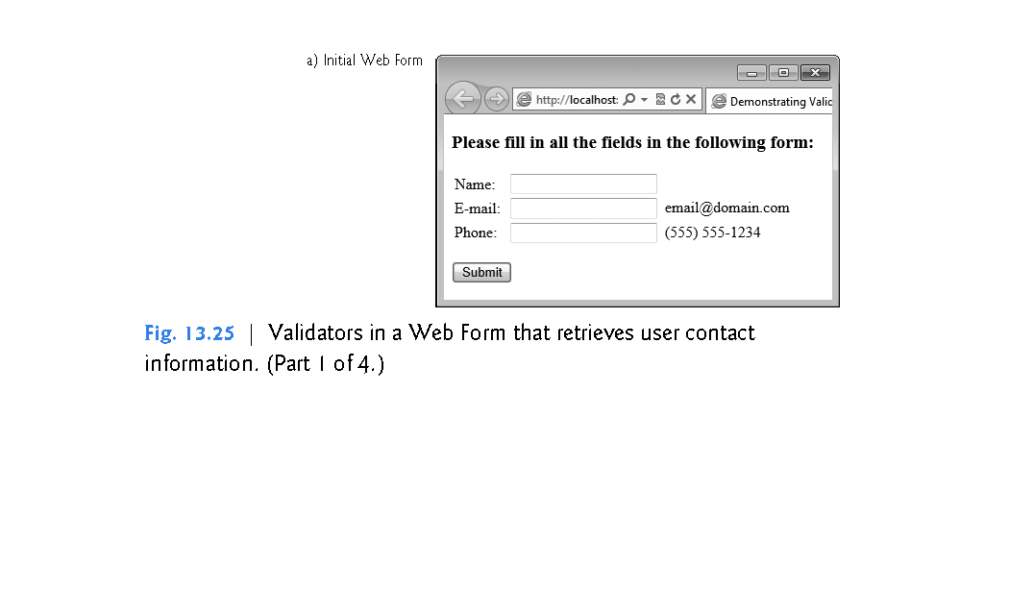

Slide 105
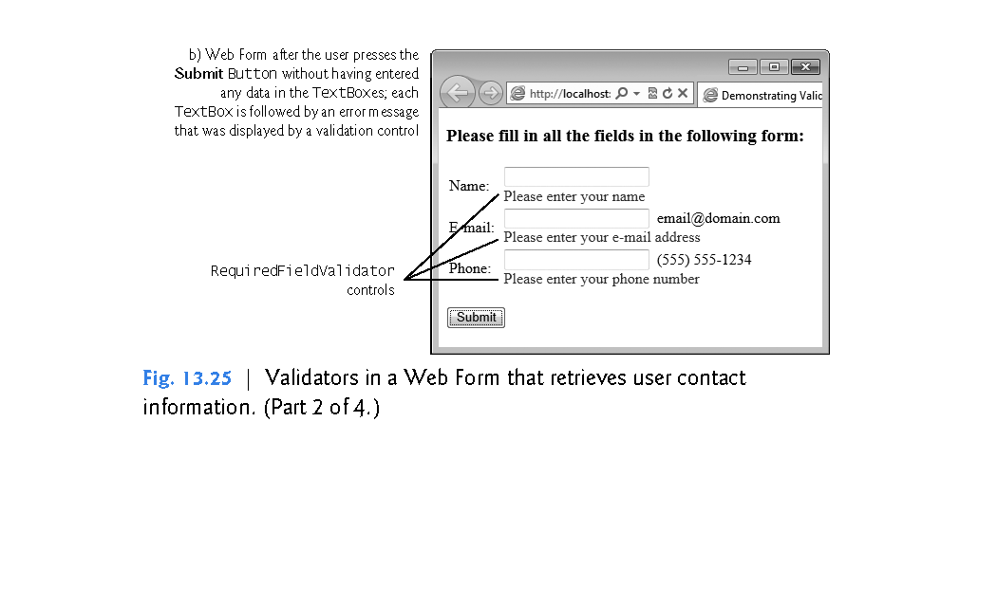

Slide 106
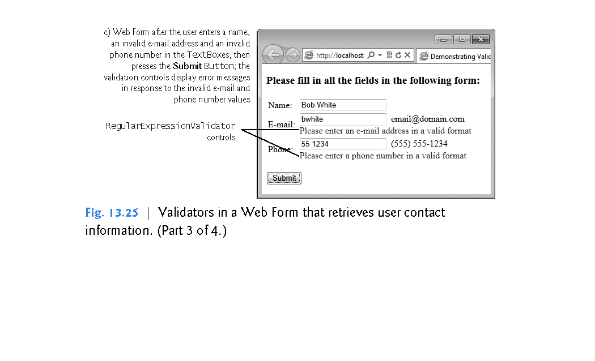

Slide 107
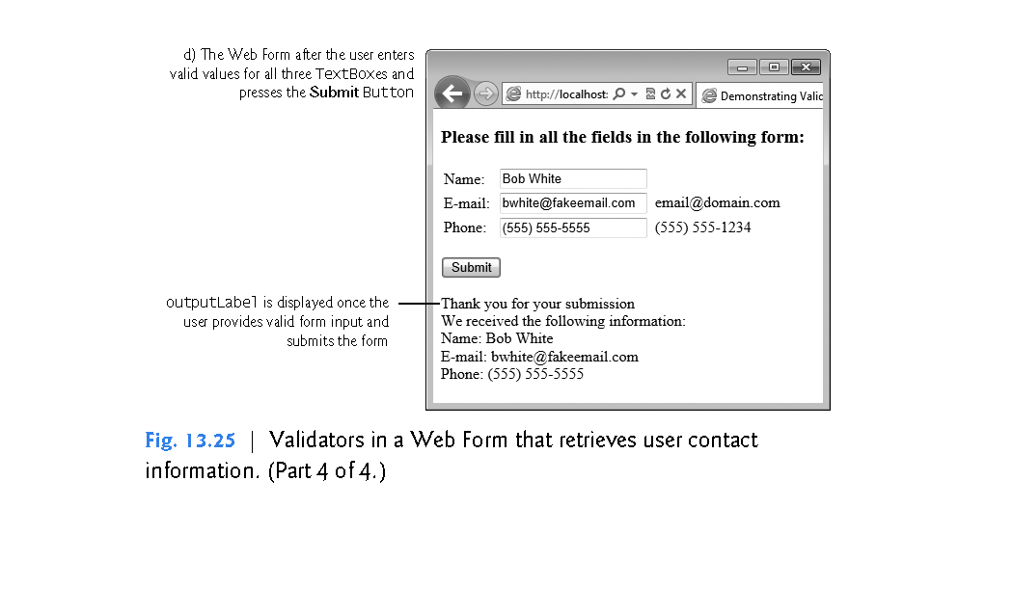

Slide 108
13.6 Validation Controls (cont.)
Step 1: Creating the Web Site
To begin, follow the steps in Section 13.4.1 to create an Empty Web Site named Validation, then add a Web Form named Validation.aspx.
Set the document’s Title property to "Demonstrating Validation Controls".
To ensure that Validation.aspx loads when you execute this app, right click it in the Solution Explorer and select Set As Start Page.

Slide 109
13.6 Validation Controls (cont.)
Step 2: Creating the GUI
To create the page, perform the following steps:
Type "Please fill in all the fields in the following form:", then use the Block Format ComboBox in the IDE’s toolbar to change the text to Heading 3 format and press Enter to create a new paragraph.
Insert a three-row and two-column table. You’ll add elements to the table momentarily.

Slide 110
13.6 Validation Controls (cont.)
Click below the table and add a Button. Set its (ID) property to submitButton and its Text property to Submit. By default, a Button control in a Web Form sends the contents of the form back to the server for processing. Select the Button then use the Block Format ComboBox in the IDE’s toolbar to wrap the Button in a Paragraph format—this places additional space above and below the Button.

Slide 111
13.6 Validation Controls (cont.)
Click to the right of the Button, then press Enter to create a new paragraph. Add a Label. Set its (ID) property to outputLabel and clear its Text property—you’ll set it programmatically when the user clicks the submitButton. Set the outputLabel’s Visible property to false, so the Label does not appear in the client’s browser when the page loads for the first time. You’ll programmatically display this Label after the user submits valid data.
Next you’ll add text and controls to the table you created in Step 2.

Slide 112
13.6 Validation Controls (cont.)
Perform the following steps:
In the left column, type the text "Name:" in the first row, "E-mail:" in the second row and "Phone:" in the third row.
In the right column of the first row, add a TextBox and set its (ID) property to nameTextBox.

Slide 113
13.6 Validation Controls (cont.)
In the right column of the second row, add a TextBox and set its (ID) property to emailTextBox. Set its TextMode property to Email—this produces an HTML5 e-mail input field when the web page is rendered in the client web browser. Click to the right of the TextBox and type the text "email@domain.com" to show an example of what the user should enter in that TextBox.

Slide 114
13.6 Validation Controls (cont.)
In the right column of the third row, add a TextBox and set its (ID) property to phoneTextBox. Set its TextMode property to Phone—this produces an HTML5 phone input field when the web page is rendered in the client web browser. Click to the right of the TextBox and type the text "(555) 555-1234" to show an example of what the user should enter in that TextBox.

Slide 115
13.6 Validation Controls (cont.)
Using RequiredFieldValidator Controls
We use three RequiredFieldValidator controls (found in the Validation section of the Toolbox) to ensure that the name, e-mail address and phone number TextBoxes are not empty when the form is submitted.
A RequiredFieldValidator makes an input control a required field.
If such a field is empty, validation fails.

Slide 116
13.6 Validation Controls (cont.)
Add a RequiredFieldValidator as follows:
Click to the right of the nameTextBox in the table and press Enter to move to the next line.
Add a RequiredFieldValidator, set its (ID) to nameRequiredFieldValidator and set the ForeColor property to Red.
Set the validator’s ControlToValidate property to nameTextBox to indicate that this validator verifies the nameTextBox’s contents.

Slide 117
13.6 Validation Controls (cont.)
Set the validator’s ErrorMessage property to "Please enter your name". This is displayed on the Web Form only if the validation fails.
Set the validator’s Display property to Dynamic, so the validator occupies space on the Web Form only when validation fails. When this occurs, space is allocated dynamically, causing the controls below the validator to shift downward to accommodate the ErrorMessage, as seen in Fig. 13.25(a)–(c).

Slide 118
13.6 Validation Controls (cont.)
Repeat these steps to add two more RequiredFieldValidators in the second and third rows of the table.
Set their (ID) properties to emailRequiredFieldValidator and phoneRequiredFieldValidator, respectively, and set their ErrorMessage properties to "Please enter your email address" and "Please enter your phone number", respectively.

Slide 119
13.6 Validation Controls (cont.)
Step 4: Using RegularExpressionValidator Controls
This example also uses two RegularExpressionValidator controls to ensure that the e-mail address and phone number entered by the user are in a valid format.
Visual Studio provides several predefined regular expressions that validate common strings like email addresses and phone numbers, which you can simply select to take advantage of this powerful validation control.

Slide 120
13.6 Validation Controls (cont.)
Add a RegularExpressionValidator as follows:
Click to the right of the emailRequiredFieldValidator in the second row of the table and add a RegularExpressionValidator, then set its (ID) to emailRegularExpressionValidator and its ForeColor property to Red.
Set the ControlToValidate property to emailTextBox to indicate that this validator verifies the emailTextBox’s contents.

Slide 121
13.6 Validation Controls (cont.)
Set the validator’s ErrorMessage property to "Please enter an e-mail address in a valid format".
Set the validator’s Display property to Dynamic, so the validator occupies space on the Web Form only when validation fails.

Slide 122
13.6 Validation Controls (cont.)
Repeat the preceding steps to add another RegularExpressionValidator in the third row of the table.
Set its (ID) property to phoneRegularExpressionValidator and its ErrorMessage property to "Please enter a phone number in a valid format", respectively.
A RegularExpressionValidator’s ValidationExpression property specifies the regular expression that validates the ControlToValidate’s contents.

Slide 123
13.6 Validation Controls (cont.)
Clicking the ellipsis next to property ValidationExpression in the Properties window displays the Regular Expression Editor dialog, which contains a list of Standard expressions for phone numbers, zip codes and other formatted information.
For the emailRegularExpressionValidator, we selected the standard expression Internet e-mail address.
If the user enters text in the emailTextBox that does not have the correct format and either clicks in a different text box or attempts to submit the form, the ErrorMessage text is displayed in red.

Slide 124
13.6 Validation Controls (cont.)
For the phoneRegularExpressionValidator, we selected U.S.
phone number to ensure that a phone number contains an optional three-digit area code either in parentheses and followed by an optional space or without parentheses and followed by a required hyphen.
After an optional area code, a phone number must contain three digits, a hyphen and another four digits.
For example, (555) 123-4567, 555-123-4567 and 123-4567 are all valid phone numbers.

Slide 125
13.6 Validation Controls (cont.)
Submitting the Web Form’s Contents to the Server
If all five validators are successful (that is, each TextBox is filled in, and the e-mail address and phone number provided are valid), clicking the Submit button sends the form’s data to the server.
As shown in Fig. 13.25(d), the server then responds by displaying the submitted data in the outputLabel.

Slide 126
13.6 Validation Controls (cont.)
Examining the Code-Behind File for a Web Form That Receives User Input
Figure 13.26 shows the code-behind file for this app.
Notice that this code-behind file does not contain any implementation related to the validators.
We’ll say more about this soon.
In this example, we respond to the page’s Load event to process the data submitted by the user.
Like the Init event, the Load event occurs each time the page loads into a web browser—the difference is that you cannot access the posted data in the controls from the Init handler.

Slide 127
13.6 Validation Controls (cont.)
The event handler for this event is Page_Load (lines 7–34).
To create the event handler, open Validation.aspx.vb in the code editor and perform the following steps, then insert the code from lines 10–33 of Fig. 13.26:
Select (Page Events) from the left ComboBox at the top of the code editor window.
Select Load from the right ComboBox at the top of the code editor window.

Slide 128
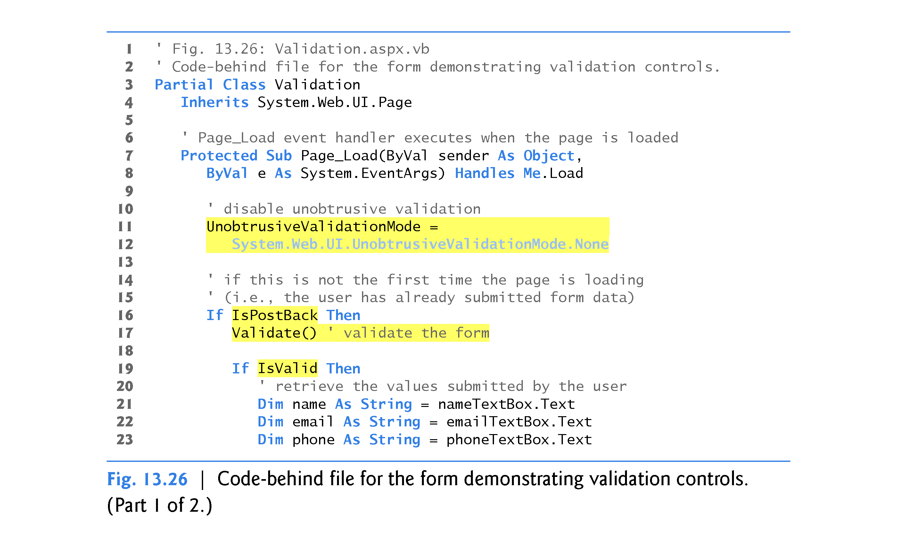

Slide 129
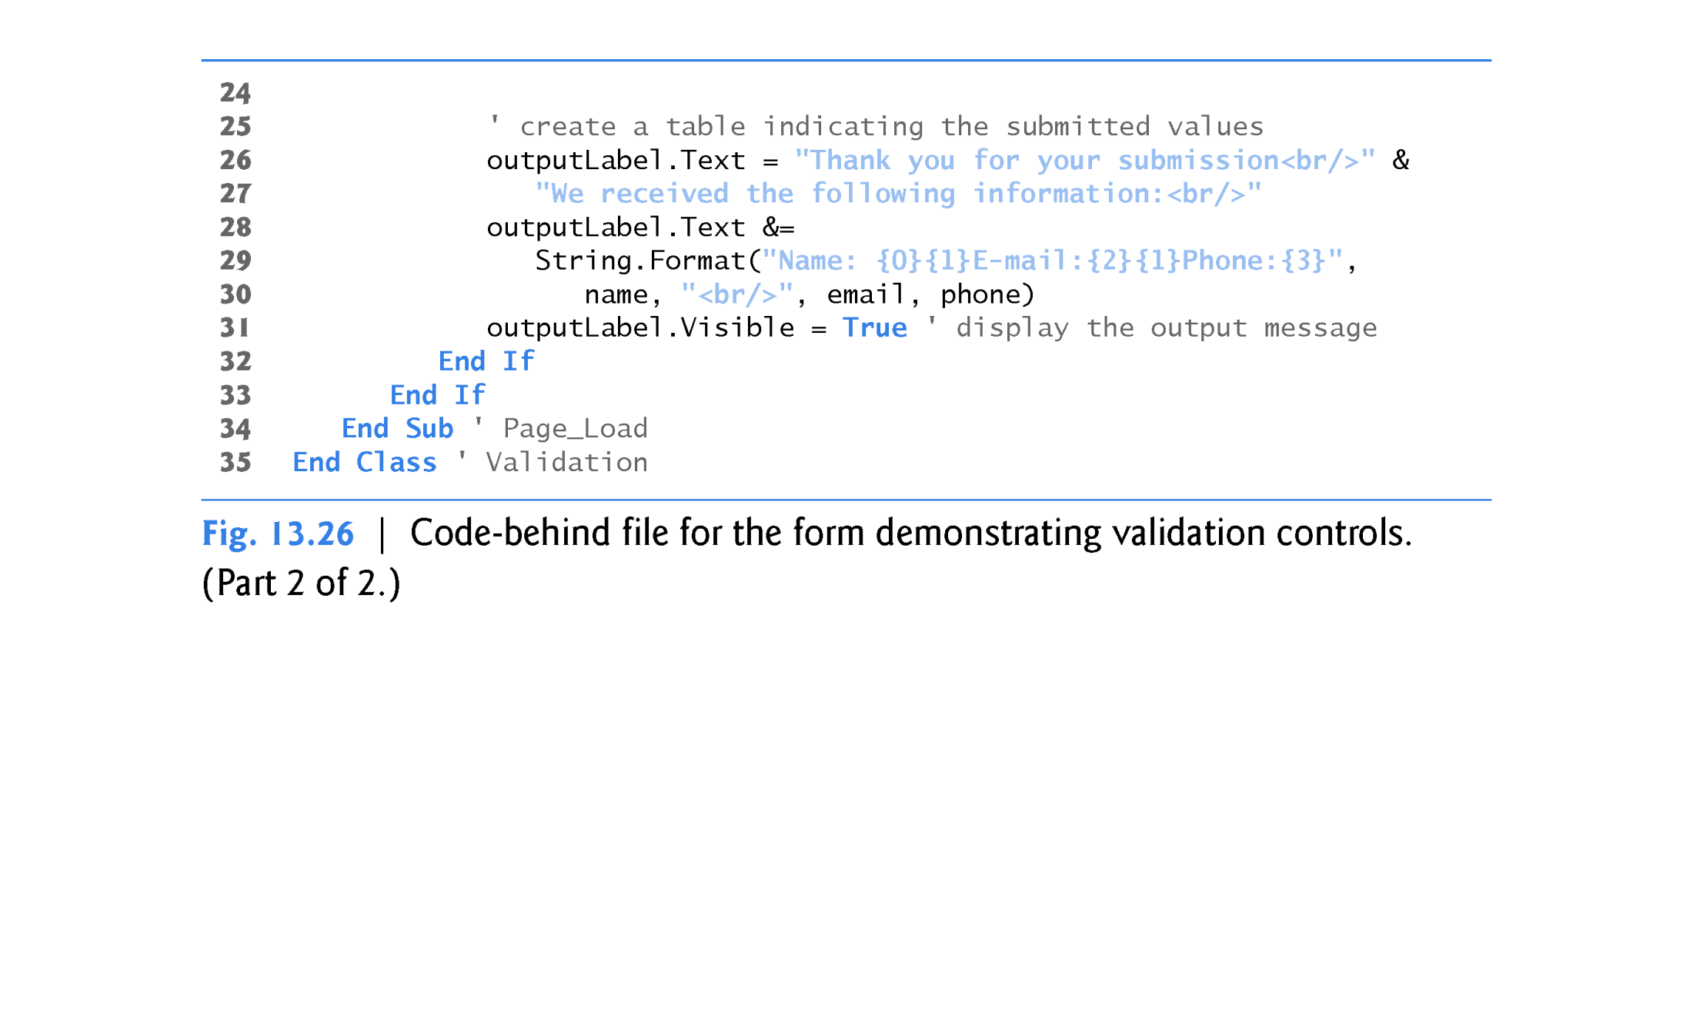

Slide 130
13.6 Validation Controls (cont.)
ASP.NET 4.5 Unobtrusive Validation
Prior to ASP.NET 4.5, when you used the validation controls presented in this section, ASP.NET would embed substantial amounts of JavaScript code in a web page to perform the work of the validation controls in the client web browser.
ASP.NET 4.5 now uses unobtrusive validation, which significantly reduces the amount of JavaScript that gets embedded into the web page—this, in turn, can improve the performance of your website by making pages load faster.

Slide 131
13.6 Validation Controls (cont.)
When you create an ASP.NET Web Forms website, everything you need for unobtrusive validation is normally configured for you—unless you create an ASP.NET Empty Web Site, as we’ve done for the examples in this chapter so far.
To enable this app to execute correctly in the web browser, lines 11–12 disable unobtrusive validation.
In the online Chapter 24, Web App Development with ASP.NET: A Deeper Look, we’ll create a website in which unobtrusive validation is properly enabled.

Slide 132
13.6 Validation Controls (cont.)
Differentiating Between the First Request to a Page and a Postback
Web programmers using ASP.NET often design their web pages so that the current page reloads when the user submits the form; this enables the program to receive input, process it as necessary and display the results in the same page when it’s loaded the second time.
These pages usually contain a form that, when submitted, sends the values of all the controls to the server and causes the current page to be requested again.

Slide 133
13.6 Validation Controls (cont.)
This event is known as a postback.
Line 16 uses the IsPostBack property of class Page to determine whether the page is being loaded due to a postback.
The first time that the web page is requested, IsPostBack is false, and the page displays only the form for user input.
When the postback occurs (from the user clicking Submit), IsPostBack is true.

Slide 134
13.6 Validation Controls (cont.)
Server-Side Web Form Validation
Server-side Web Form validation must be implemented programmatically.
Line 17 calls the current Page’s Validate method to validate the information in the request.
This validates the information as specified by the validation controls in the Web Form.

Slide 135
13.6 Validation Controls (cont.)
Line 19 uses the IsValid property of class Page to check whether the validation succeeded.
If this property is set to True (that is, validation succeeded and the Web Form is valid), then we display the Web Form’s information.
Otherwise, the web page loads without any changes, except that any validator that failed now displays its ErrorMessage.

Slide 136
13.6 Validation Controls (cont.)
Processing the Data Entered by the User
Lines 21–23 retrieve the values of nameTextBox, emailTextBox and phoneTextBox.
When data is posted to the web server, the data that the user entered is accessible to the web app through the web controls’ properties.

Slide 137
13.6 Validation Controls (cont.)
Next, lines 26–30 set outputLabel’s Text to display a message that includes the name, e-mail and phone information that was submitted to the server.
In lines 26, 27 and 30, notice the use of <br/> rather than \n to start new lines in the outputLabel—<br/> is the markup for a line break in a web page.
Line 31 sets the outputLabel’s Visible property to true, so the user can see the thank-you message and submitted data when the page reloads in the client web browser.

Slide 138
13.7 Session Tracking
Originally, critics accused the Internet and e-business of failing to provide the customized service typically experienced in “brick-and-mortar” stores.
To address this problem, businesses established mechanisms by which they could personalize users’ browsing experiences, tailoring content to individual users.
Businesses can achieve this level of service by tracking each customer’s movement through the Internet and combining the collected data with information provided by the consumer, including billing information, personal preferences, interests and hobbies.

Slide 139
13.7 Session Tracking (cont.)
Personalization
Personalization makes it possible for businesses to communicate effectively with their customers and also improves users’ ability to locate desired products and services.
Companies that provide content of particular interest to users can establish relationships with customers and build on those relationships over time.
Furthermore, by targeting consumers with personal offers, recommendations, advertisements, promotions and services, businesses create customer loyalty.

Slide 140
13.7 Session Tracking (cont.)
Websites can use sophisticated technology to allow visitors to customize home pages to suit their individual needs and preferences.
Similarly, online shopping sites often store personal information for customers, tailoring notifications and special offers to their interests.
Such services encourage customers to visit sites more frequently and make purchases more regularly.

Slide 141
13.7 Session Tracking (cont.)
Privacy
A trade-off exists between personalized business service and protection of privacy.
Some consumers embrace tailored content, but others fear the possible adverse consequences if the info they provide to businesses is released or collected by tracking technologies.
Consumers and privacy advocates ask:
What if the business to which we give personal data sells or gives that information to other organizations without our knowledge?

Slide 142
13.7 Session Tracking (cont.)
What if we do not want our actions on the Internet—a supposedly anonymous medium—to be tracked and recorded by unknown parties?
What if unauthorized parties gain access to sensitive private data, such as credit-card numbers or medical history?
These are questions that must be addressed by programmers, consumers, businesses and lawmakers alike.

Slide 143
13.7 Session Tracking (cont.)
Recognizing Clients
To provide personalized services to consumers, businesses must be able to recognize clients when they request information from a site.
As we’ve discussed, the request/response system on which the web operates is facilitated by HTTP.
Unfortunately, HTTP is a stateless protocol—it does not provide information that would enable web servers to maintain state information regarding particular clients.

Slide 144
13.7 Session Tracking (cont.)
This means that web servers cannot determine whether a request comes from a particular client or whether the same or different clients generate a series of requests.
To circumvent this problem, sites can provide mechanisms by which they identify individual clients.
A session represents a unique client on a website.
If the client leaves a site and then returns later, the client will still be recognized as the same user.

Slide 145
13.7 Session Tracking (cont.)
When the user closes the browser, the session typically ends.
To help the server distinguish among clients, each client must identify itself to the server.
Tracking individual clients is known as session tracking.
One popular session-tracking technique uses cookies (discussed in Section 13.7.1); another uses ASP.NET’s HttpSessionState object (used in Section 13.7.1).
Additional session-tracking techniques are beyond this book’s scope.

Slide 146
13.7.1 Cookies
Cookies provide you with a tool for personalizing web pages.
A cookie is a piece of data stored by web browsers in a small text file on the user’s computer.
A cookie maintains information about the client during and between browser sessions.
The first time a user visits the website, the user’s computer might receive a cookie from the server; this cookie is then reactivated each time the user revisits that site.
The collected information is intended to be an anonymous record containing data that's used to personalize the user’s future visits to the site.

Slide 147
13.7.1 Cookies (cont.)
For example, cookies in a shopping app might store unique identifiers for users.
When a user adds items to an online shopping cart or performs another task resulting in a request to the web server, the server receives a cookie containing the user’s unique identifier.
The server then uses the unique identifier to locate the shopping cart and perform any necessary processing.
In addition to identifying users, cookies also can indicate users’ shopping preferences.

Slide 148
13.7.1 Cookies (cont.)
When a Web Form receives a request from a client, the Web Form can examine the cookie(s) it sent to the client during previous communications, identify the user’s preferences and immediately display products of interest to the client.
Every HTTP-based interaction between a client and a server includes a header containing information either about the request (when the communication is from the client to the server) or about the response (when the communication is from the server to the client).

Slide 149
13.7.1 Cookies (cont.)
When a Web Form receives a request, the header includes information such as the request type and any cookies that have been sent previously from the server to be stored on the client machine.
When the server formulates its response, the header information contains any cookies the server wants to store on the client computer and other information, such as the type of data in the response.
The expiration date of a cookie determines how long the cookie remains on the client’s computer.

Slide 150
13.7.1 Cookies (cont.)
If you do not set an expiration date for a cookie, the web browser maintains the cookie for the duration of the browsing session.
Otherwise, the web browser maintains the cookie until the expiration date occurs.
Cookies are deleted when they expire.

Slide 151
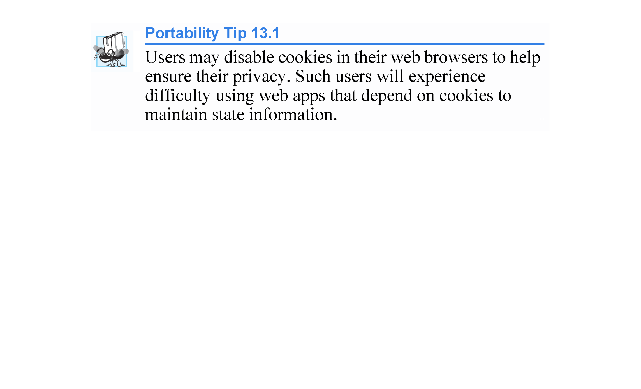

Slide 152
13.7.1 Session Tracking with HttpSessionState
The next web app demonstrates session tracking using class HttpSessionState.
When you execute this app, the Options.aspx page (Fig. 13.27(a)), which is the app’s Start Page, allows the user to select a programming language from a group of radio buttons.
[Note: You might need to right click Options.aspx in the Solution Explorer and select Set As Start Page before running this app.]
When the user clicks Submit, the selection is sent to the web server for processing.

Slide 153
13.7.1 Session Tracking with HttpSessionState (cont.)
The web server uses an HttpSessionState object to store the chosen language and the ISBN number for one of our books on that topic.
Each user that visits the site has a unique HttpSessionState object, so the selections made by one user are maintained separately from all other users.
After storing the selection, the server returns the page to the browser (Fig. 13.27(b)) and displays the user’s selection and some information about the user’s unique session (which we show just for demonstration purposes).

Slide 154
13.7.1 Session Tracking with HttpSessionState (cont.)
The page also includes links that allow the user to choose between selecting another programming language or viewing the Recommendations.aspx page (Fig. 13.27(e)), which lists recommended books pertaining to the programming language(s) that the user selected previously.
If the user clicks the link for book recommendations, the information stored in the user’s unique HttpSessionState object is read and used to form the list of recommendations.

Slide 155
13.7.1 Session Tracking with HttpSessionState (cont.)
To test this app:
Select Open Web Site… from the FILE menu.
In the Open Web Site dialog, ensure that File System is selected, then navigate to this chapter’s examples, select the Sessions folder and click the Open Button.
Select Options.aspx in the Solution Explorer, then type Ctrl + F5 to execute the web app in your default web browser.

Slide 156
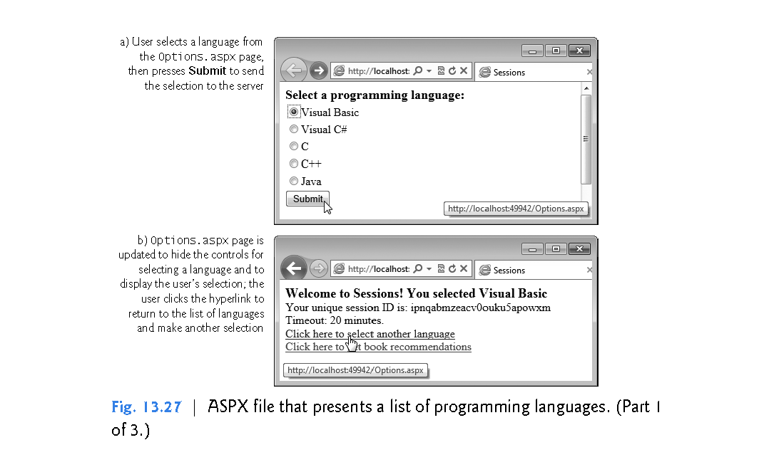

Slide 157
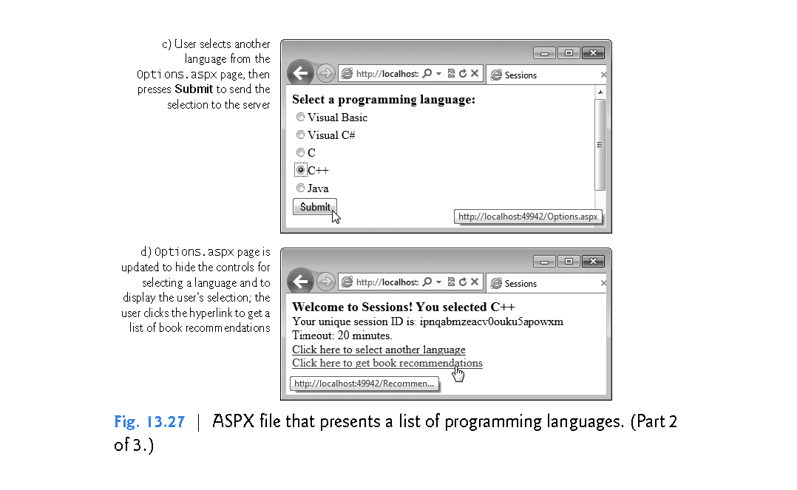

Slide 158
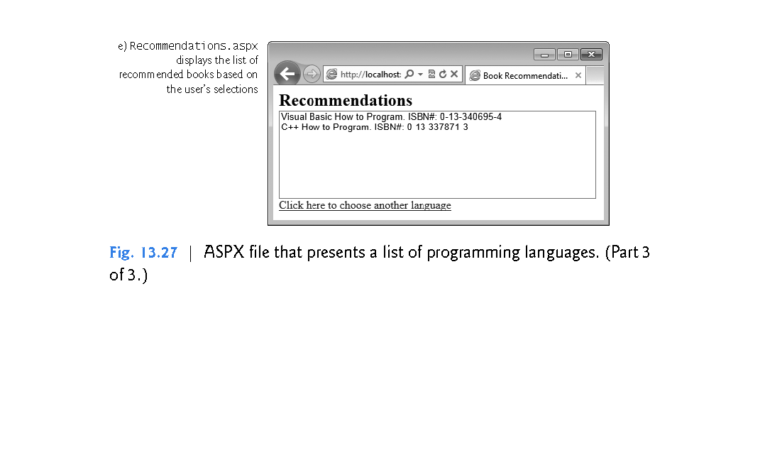

Slide 159
13.7.2 Session Tracking with HttpSessionState
Creating the Web Site
To begin, follow the steps in Section 13.4.1 to create an Empty Web Site named Sessions, then add two Web Forms named Options.aspx and Recommendations.aspx to the project.
Set the Options.aspx document’s Title property to "Sessions" and the Recommendations.aspx document’s Title property to "Book Recommendations".
To ensure that Options.aspx is the first page to load for this app, right click it in the Solution Explorer and select Set As Start Page.

Slide 160
13.7.3 Options.aspx: Selecting a Programming Language
The Options.aspx page Fig. 13.27(a) contains the following controls arranged vertically:
A Label with its (ID) property set to promptLabel and its Text property set to "Select a programming language:". We used the techniques shown in Step 5 of Section 13.4.1 to create a CSS style for this label named .labelStyle, and set the style’s font-size attribute to large and the font-weight attribute to bold.

Slide 161
13.7.3 Options.aspx: Selecting a Programming Language (cont.)
The user selects a programming language by clicking one of the radio buttons in a RadioButtonList. Each radio button has a Text property and a Value property. The Text property is displayed next to the radio button and the Value property represents a value that's sent to the server when the user selects that radio button and submits the form. In this example, we’ll use the Value property to represent the ISBN for the recommended book.

Slide 162
13.7.3 Options.aspx: Selecting a Programming Language (cont.)
Create a RadioButtonList with its (ID) property set to languageList. Use the ListItem Collection Editor to add five radio buttons with their Text properties set to Visual Basic, Visual C#, C, C++ and Java and their Value properties set to 0-13-340695-4, 0-13-337933-7, 0-13-299044-X, 0-13-337871-3 and 0-13-294094-9, respectively.

Slide 163
13.7.3 Options.aspx: Selecting a Programming Language (cont.)
A Button with its (ID) property set to submitButton and its Text property set to Submit. In this example, we’ll handle this Button’s Click event. You can create its event handler by double clicking the Button in Design view.

Slide 164
13.7.3 Options.aspx: Selecting a Programming Language (cont.)
A Label with its (ID) property set to responseLabel and its Text property set to "Welcome to Sessions!". This Label should be placed immediately to the right of the Button so that the Label appears at the top of the page when we hide the preceding controls on the page. Reuse the CSS style you created in Step 1 by setting this Label’s CssClass property to labelStyle.

Slide 165
13.7.3 Options.aspx: Selecting a Programming Language (cont.)
Two more Labels with their (ID) properties set to idLabel and timeoutLabel, respectively. Clear the text in each Label’s Text property—you’ll set these programmatically with information about the current user’s session.
A HyperLink with its (ID) property set to languageLink and its Text property set to "Click here to choose another language". Set its NavigateUrl property by clicking the ellipsis next to the property in the Properties window and selecting Options.aspx from the Select URL dialog.

Slide 166
13.7.3 Options.aspx: Selecting a Programming Language (cont.)
A HyperLink with its (ID) property set to recommendationsLink and its Text property set to "Click here to get book recommendations". Set its NavigateUrl property by clicking the ellipsis next to the property in the Properties window and selecting Recommendations.aspx from the Select URL dialog.
Initially, the controls in Steps 4–7 will not be displayed, so set each control’s Visible property to false.

Slide 167
13.7.3 Options.aspx: Selecting a Programming Language (cont.)
Session Property of a Page
Every ASP.NET Web app includes a user-specific HttpSessionState object, which is accessible through property Session of class Page.
Throughout this section, we use this property to manipulate the current user’s HttpSessionState object.
When the user first requests a page in a Web app, a unique HttpSessionState object is created by ASP.NET and assigned to the Page’s Session property.
The same object is also available to the app’s other pages.

Slide 168
13.7.3 Options.aspx: Selecting a Programming Language (cont.)
Code-Behind File for Options.aspx
Fig. 13.28 presents the code-behind file for the Options.aspx page.
When this page is requested, the Page_Load event handler (lines 9–40) executes before the response is sent to the client.
Since the first request to a page is not a postback, the code in lines 15–38 does not execute the first time the page loads.

Slide 169
13.7.3 Options.aspx: Selecting a Programming Language (cont.)
Postback Processing
When the user presses Submit, a postback occurs.
The form is submitted to the server and Page_Load executes.
Lines 15–19 display the controls shown in Fig. 13.27(b) and lines 22–24 hide the controls shown in Fig. 13.27(a).
Next, lines 27–32 ensure that the user selected a language and, if so, display a message in the responseLabel indicating the selection.
Otherwise, the message "You did not select a language" is displayed.

Slide 170
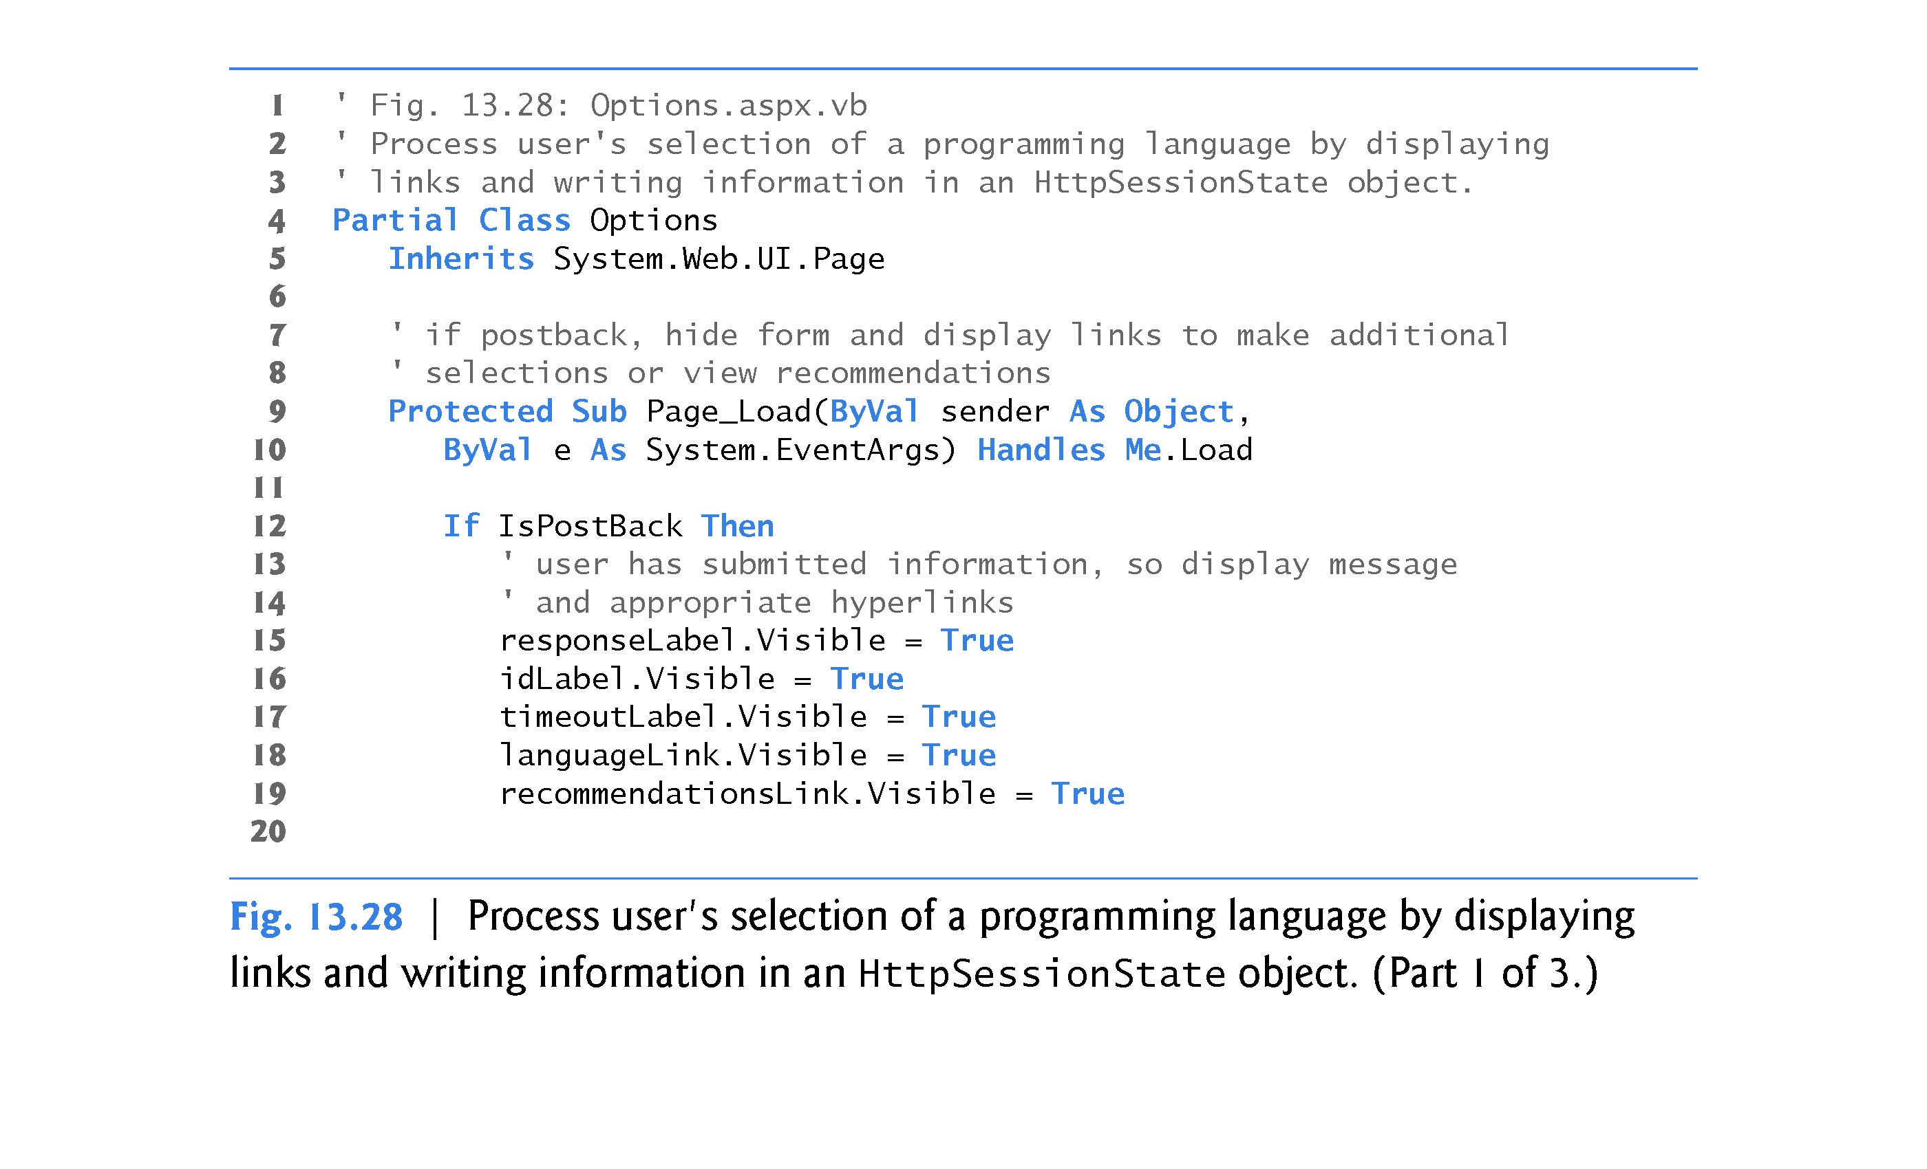

Slide 171
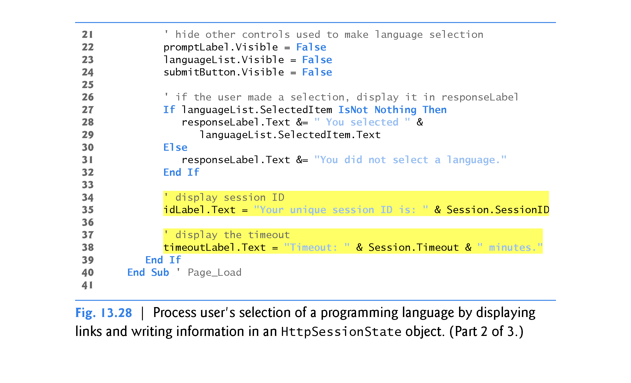

Slide 172
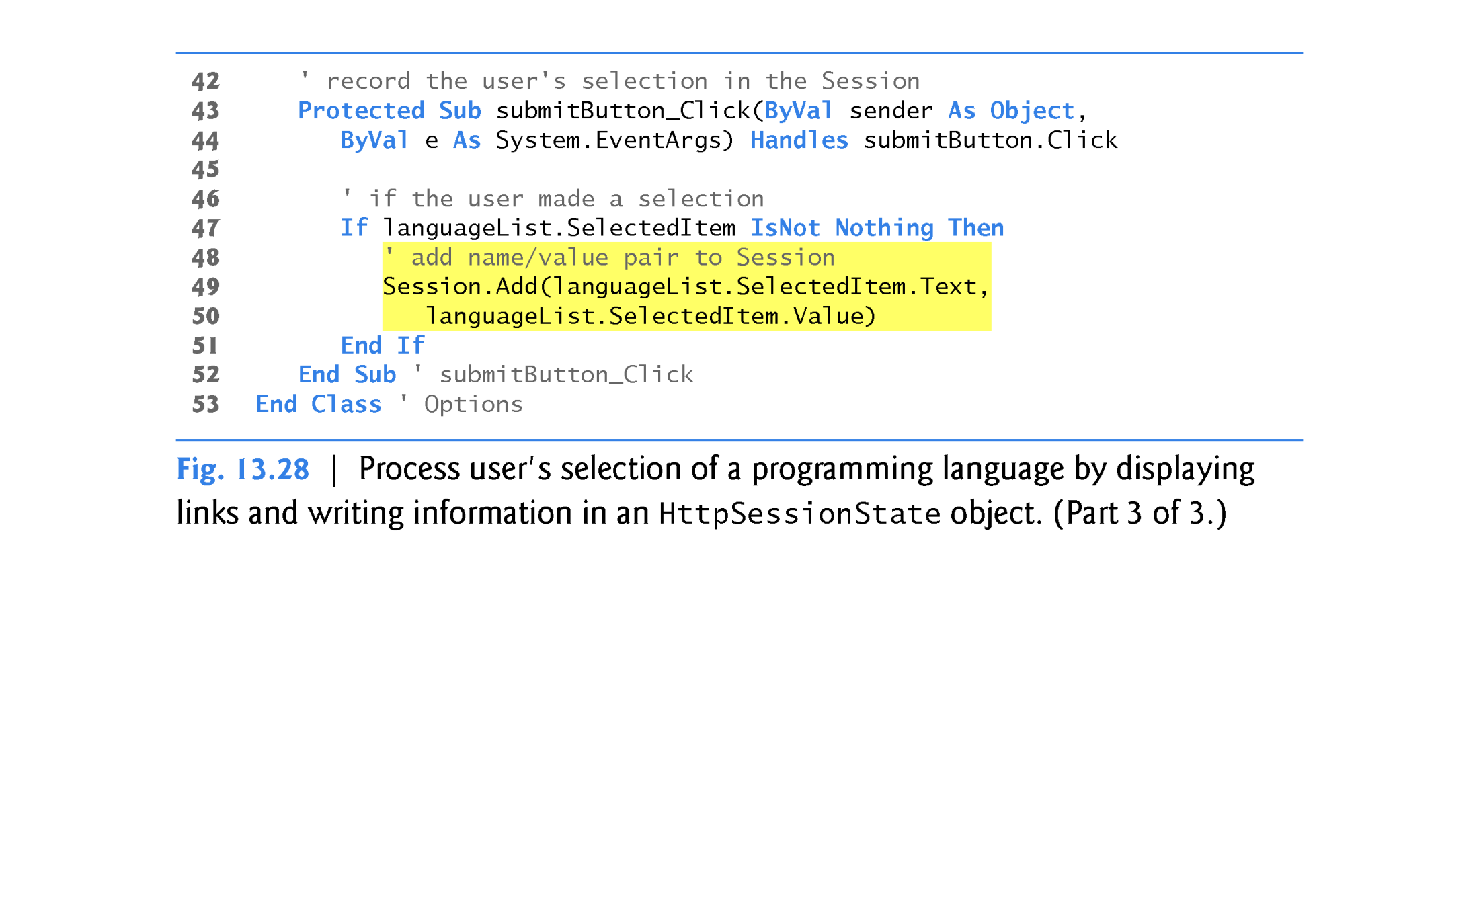

Slide 173
13.7.3 Options.aspx: Selecting a Programming Language (cont.)
The ASP.NET app contains information about the HttpSessionState object (property Session of the Page object) for the current client.
The object’s SessionID property (displayed in line 35) contains the unique session ID—a sequence of random letters and numbers.
The first time a client connects to the web server, a unique session ID is created for that client and a temporary cookie is written to the client so the server can identify the client on subsequent requests.
When the client makes additional requests, the client’s session ID from that temporary cookie is compared with the session IDs stored in the web server’s memory to retrieve the client’s HttpSessionState object.

Slide 174
13.7.3 Options.aspx: Selecting a Programming Language (cont.)
HttpSessionState property Timeout (displayed in line 38) specifies the maximum amount of time that an HttpSessionState object can be inactive before it’s discarded.
By default, if the user does not interact with this web app for 20 minutes, the HttpSessionState object is discarded by the server and a new one will be created if the user interacts with the app again.
Figure 13.29 lists some common HttpSessionState properties.

Slide 175
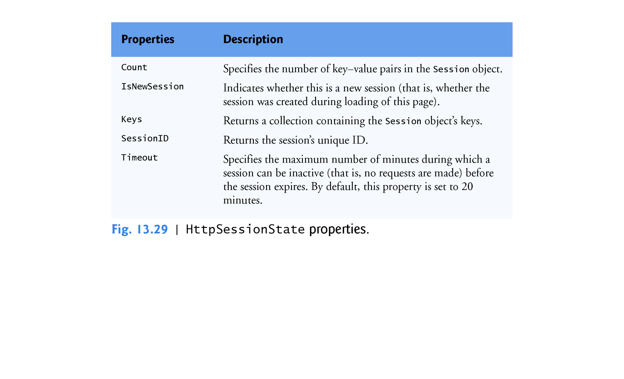

Slide 176
13.7.3 Options.aspx: Selecting a Programming Language (cont.)
Method submitButton_Click
We store the user’s selection in an HttpSessionState object when the user clicks the Submit Button.
The submitButton_Click event handler (lines 43–52) adds a key-value pair to the HttpSessionState object for the current user, specifying the language chosen and the ISBN number for a book on that language.
The HttpSessionState object is a dictionary—a data structure that stores key-value pairs.

Slide 177
13.7.3 Options.aspx: Selecting a Programming Language (cont.)
A program uses the key to store and retrieve the associated value in the dictionary.
The key-value pairs in an HttpSessionState object are often referred to as session items.
They’re placed in an HttpSessionState object by calling its Add method.

Slide 178
13.7.3 Options.aspx: Selecting a Programming Language (cont.)
If the user made a selection (line 47), lines 49–50 get the selection and its corresponding value from the languageList by accessing its SelectedItem’s Text and Value properties, respectively, then call HttpSessionState method Add to add this name-value pair as a session item in the HttpSessionState object (Session).

Slide 179
13.7.3 Options.aspx: Selecting a Programming Language (cont.)
If the app adds a session item that has the same name as an item previously stored in the HttpSessionState object, the session item is replaced—session item names must be unique.
Another common syntax for placing a session item in the HttpSessionState object is Session(Name) = Value.
For example, we could have replaced lines 49–50 with
Session(languageList.SelectedItem.Text) = languageList.SelectedItem.Value

Slide 180
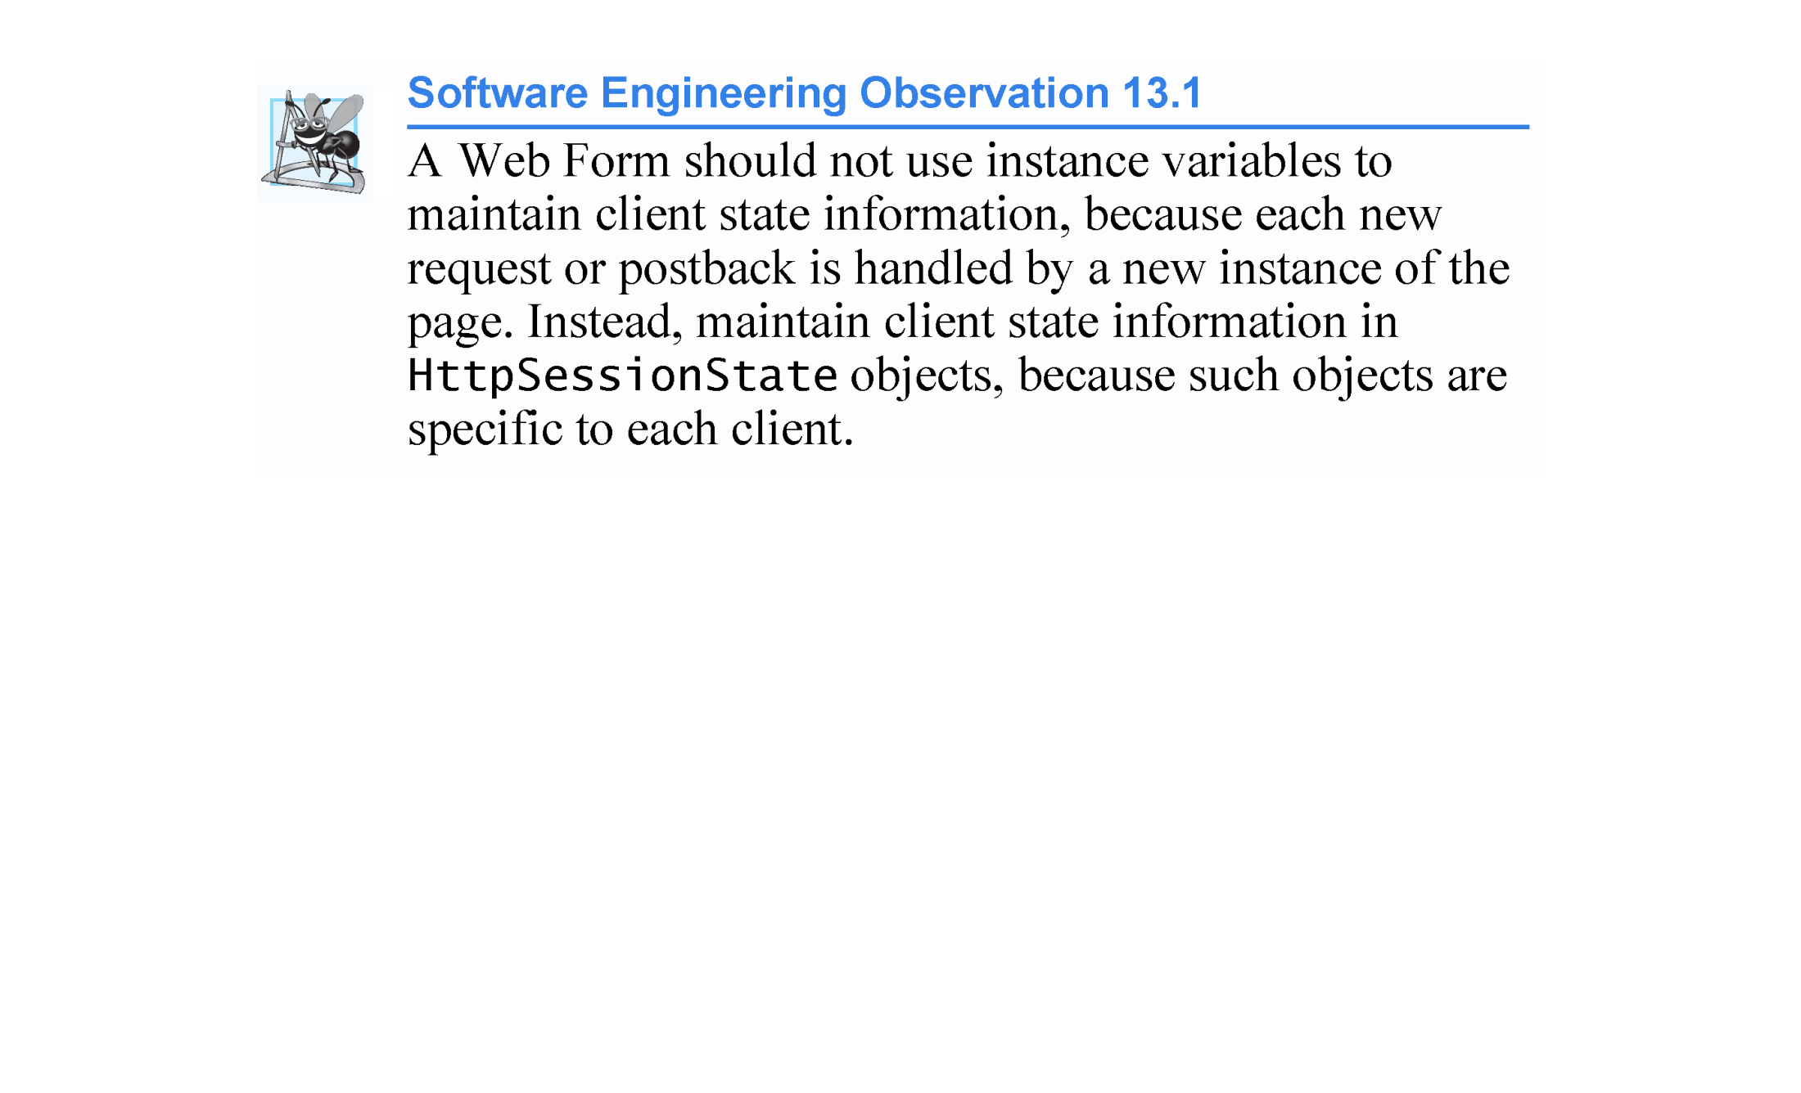

Slide 181
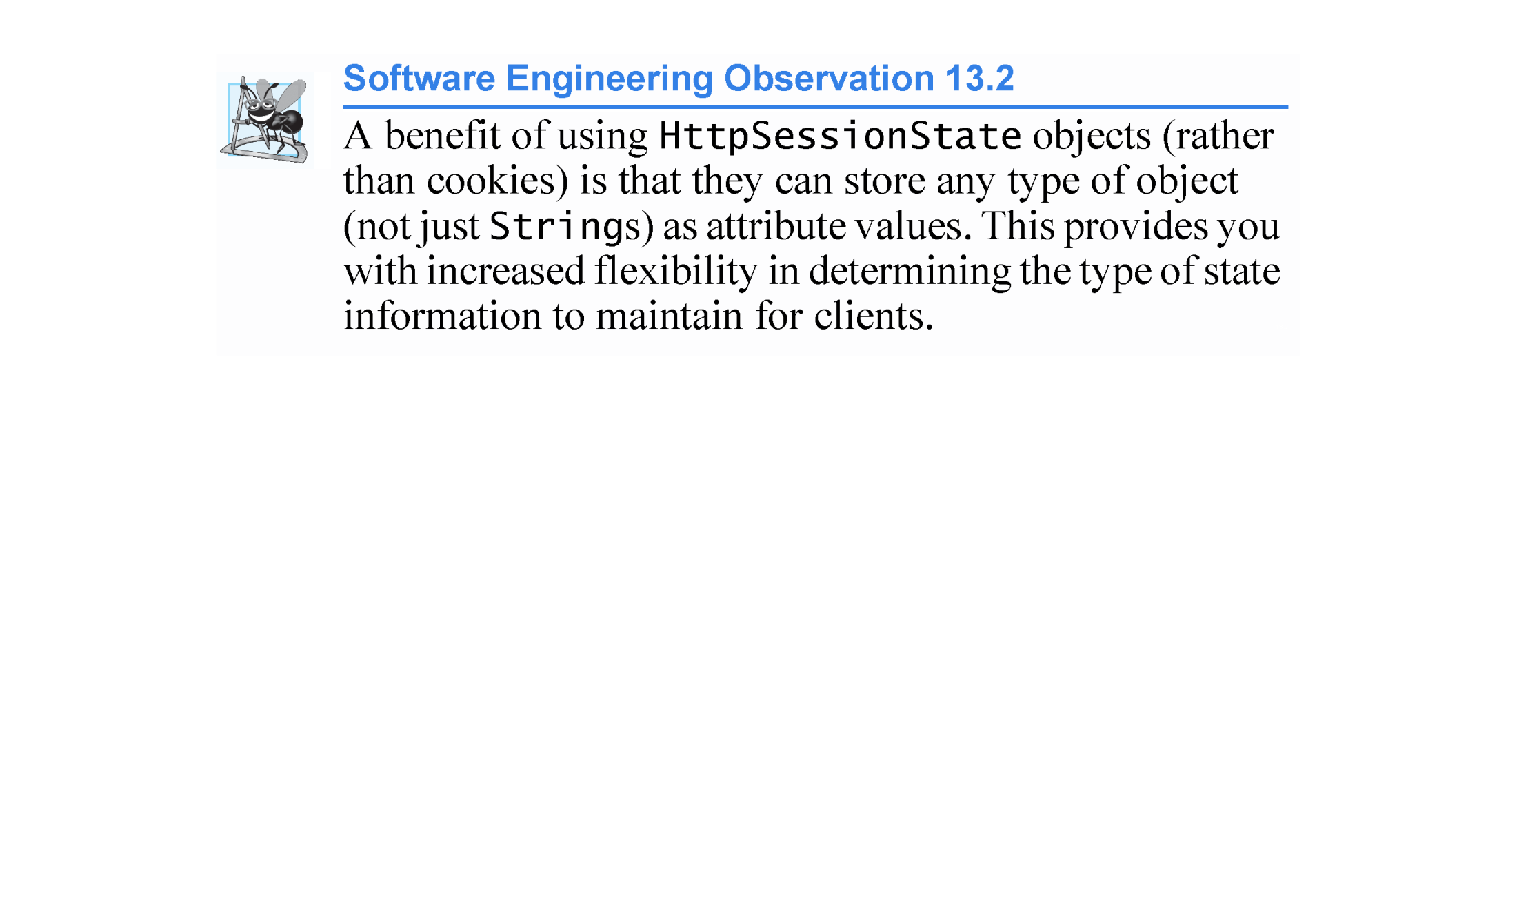

Slide 182
13.7.4 Recommendations.aspx: Displaying Recommendations Based on Session Values
After the postback of Options.aspx, the user may request book recommendations.
The book-recommendations hyperlink forwards the user to the page Recommendations.aspx (Fig. 13.27(e)) to display the recommendations based on the user’s language selections.

Slide 183
13.7.4 Recommendations.aspx: Displaying Recommendations Based on Session Values (cont.)
The page contains the following controls arranged vertically:
A Label with its (ID) property set to recommendationsLabel and its Text property set to "Recommendations:". We created a CSS style for this label named .labelStyle, and set the font-size attribute to x-large and the font-weight attribute to bold. (See Step 5 in Section 13.4.1 for information on creating a CSS style.)

Slide 184
13.7.4 Recommendations.aspx: Displaying Recommendations Based on Session Values (cont.)
A ListBox with its (ID) property set to booksListBox. We created a CSS style for this ListBox named .listBoxStyle. In the Position category, we set the width attribute to 450px and the height attribute to 125px. The px indicates that the measurement is in pixels.

Slide 185
13.7.4 Recommendations.aspx: Displaying Recommendations Based on Session Values (cont.)
A HyperLink with its (ID) property set to languageLink and its Text property set to "Click here to choose another language". Set its NavigateUrl property by clicking the ellipsis next to the property in the Properties window and selecting Options.aspx from the Select URL dialog. When the user clicks this link, the Options.aspx page will be reloaded. Requesting the page in this manner is not considered a postback, so the original form in Fig. 13.27(a) will be displayed.

Slide 186
13.7.4 Recommendations.aspx: Displaying Recommendations Based on Session Values (cont.)
Code-Behind File for Recommendations.aspx
Figure 13.30 presents the code-behind file for Recommendations.aspx.
Event handler Page_Init (lines 7–26) retrieves the session information.
If a user has not selected a language in the Options.aspx page, the HttpSessionState object’s Count property will be 0 (line 11).
This property provides the number of session items contained in a HttpSessionState object.
If the Count is 0, then we display the text No Recommendations (line 20), hide the ListBox (line 21), and update the Text of the HyperLink back to Options.aspx (line 24).

Slide 187
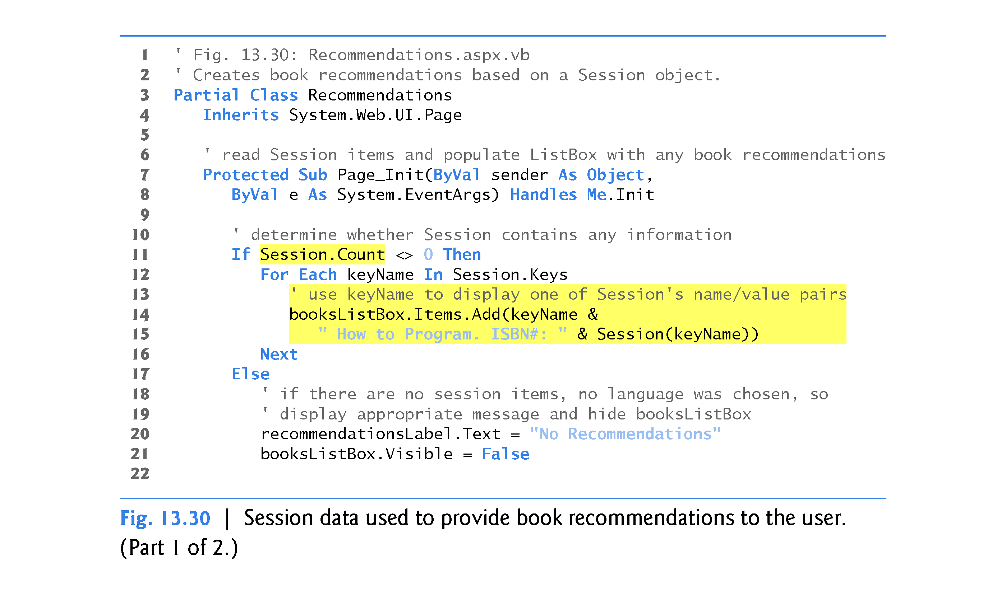

Slide 188
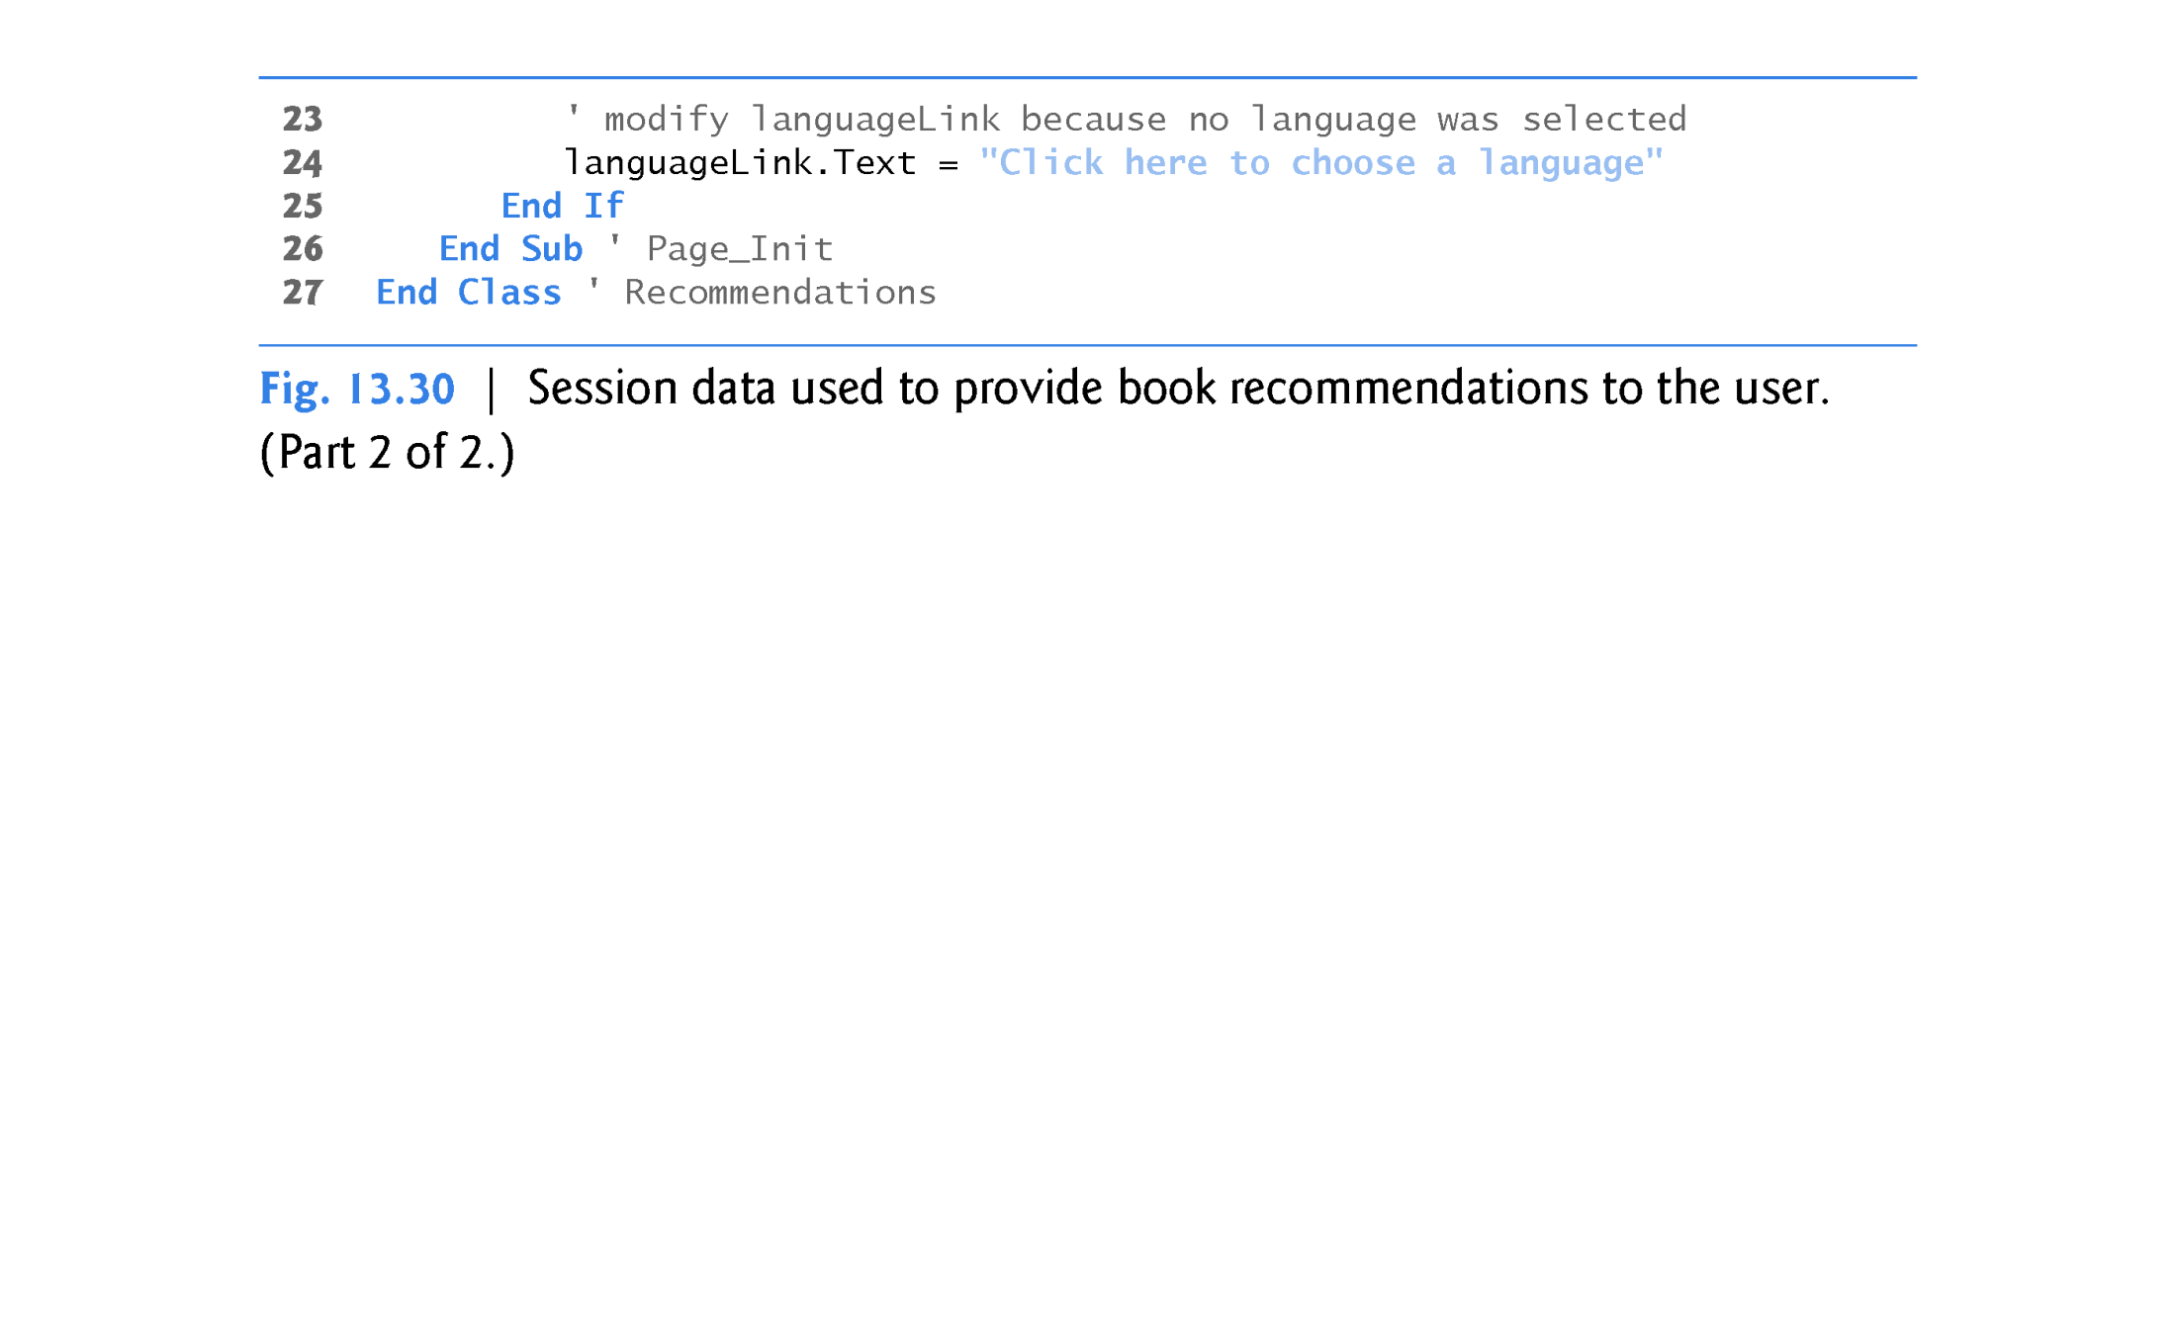

Slide 189
13.7.4 Recommendations.aspx: Displaying Recommendations Based on Session Values (cont.)
If the user chose at least one language, the loop in lines 12–16 iterates through the HttpSessionState object’s keys by accessing the HttpSessionState’s Keys property, which returns a collection containing all the keys in the session.
Lines 14–15 concatenate the keyName, the String " How to Program.
ISBN#: " and the key’s corresponding value, which is returned by Session(keyName).
This String is the recommendation that's added to the ListBox.

Slide 190
13.8 Case Study: Database-Driven ASP.NET Guestbook
Many websites allow users to provide feedback about the website in a guestbook.
Typically, users click a link on the website’s home page to request the guestbook page.
This page usually consists of a form that contains fields for the user’s name, e-mail address, message/feedback and so on.
Data submitted on the guestbook form is then stored in a database located on the server.
In this section, we create a guestbook Web Form app.

Slide 191
13.8 Case Study: Database-Driven ASP.NET Guestbook (cont.)
The GUI (Fig. 13.31) contains a GridView data control, which displays all the entries in the guestbook in tabular format.
This control is located in the Toolbox’s Data section.
We explain how to create and configure this data control shortly.
The GridView displays abc in Design mode to indicate data that will be retrieved from a data source at runtime.
You’ll learn how to create and configure the GridView shortly.

Slide 192
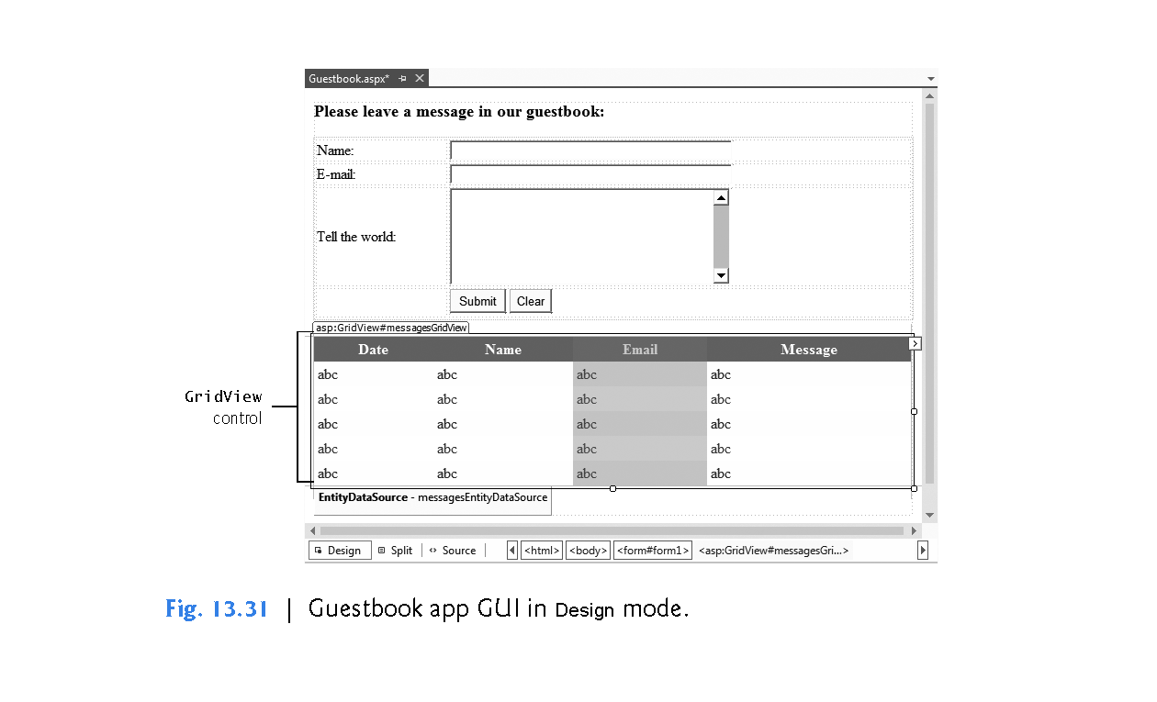

Slide 193
13.8 Case Study: Database-Driven ASP.NET Guestbook (cont.)
The Guestbook Database
The app stores the guestbook information in a SQL Server database called Guestbook.mdf located on the web server.
(We provide this database in the databases folder with this chapter’s examples.) The database contains a single table named Messages.

Slide 194
13.8 Case Study: Database-Driven ASP.NET Guestbook (cont.)
Testing the App
To test this app: Select Open Web Site… from the FILE menu.
In the Open Web Site dialog, ensure that File System is selected, then navigate to this chapter’s examples, select the Guestbook folder and click the Open Button.
Select Guestbook.aspx in the Solution Explorer, then type Ctrl + F5 to execute the web app in your default web browser.
Figure 13.32(a) shows the user submitting a new entry.
Figure 13.32(b) shows the new entry as the last row in the GridView.

Slide 195
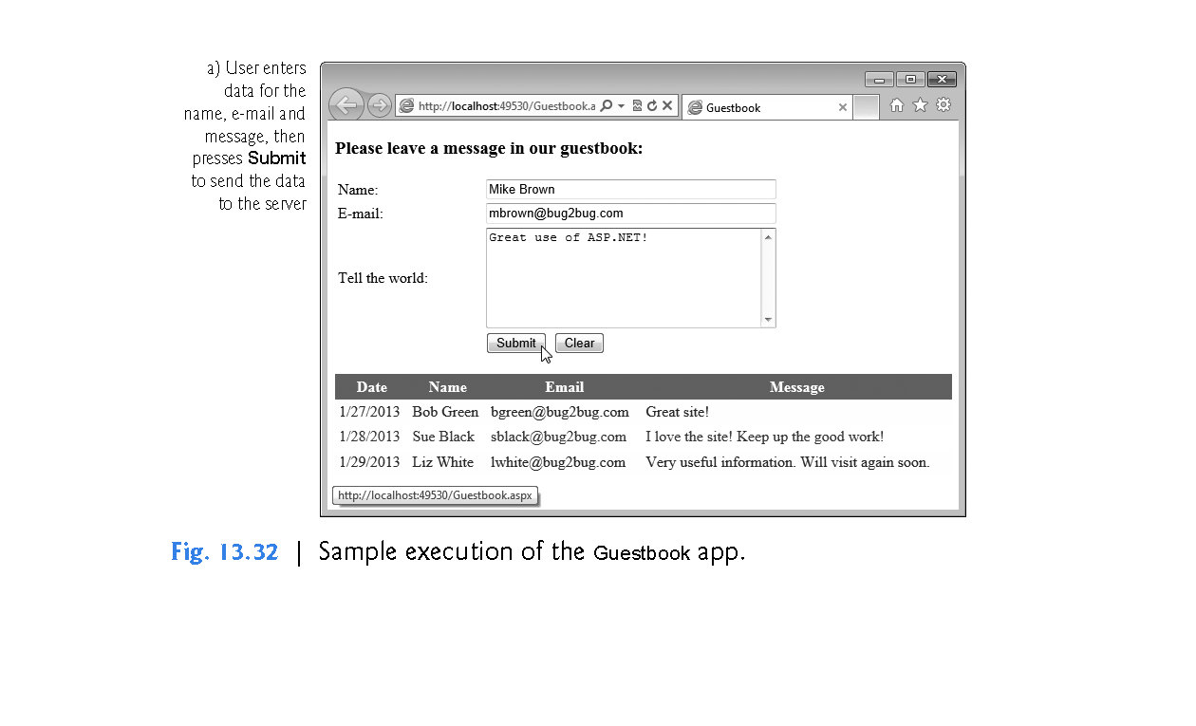

Slide 196
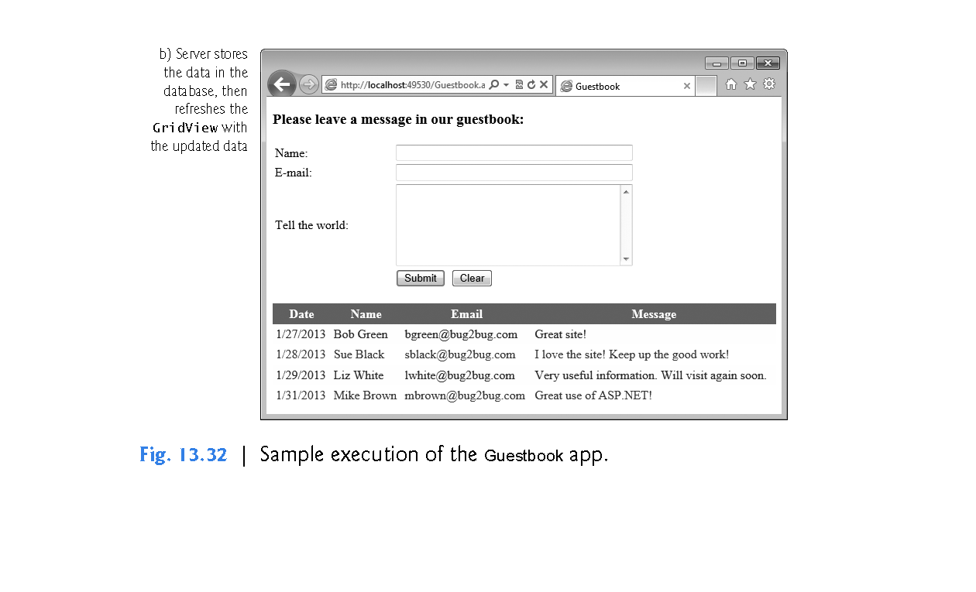

Slide 197
13.8.1 Building a Web Form that Displays Data from a Database
You’ll now build this GUI and set up the data binding between the GridView control and the database.
Many of these steps are similar to those performed in Chapter 12 to access and interact with a database in a Windows app.
We discuss the code-behind file in Section 13.8.2.

Slide 198
13.8.1 Building a Web Form that Displays Data from a Database (cont.)
Step 1: Creating the Web Site
To begin, follow the steps in Section 13.4.1 to create an Empty Web Site named Guestbook then add a Web Form named Guestbook.aspx to the project.
Set the document’s Title property to "Guestbook".
To ensure that Guestbook.aspx loads when you execute this app, right click it in the Solution Explorer and select Set As Start Page.

Slide 199
13.8.1 Building a Web Form that Displays Data from a Database (cont.)
Step 2: Creating the Form for User Input
In Design mode, add the text Please leave a message in our guestbook:, then use the Block Format ComboBox in the IDE’s toolbar to change the text to Heading 3 format.
Insert a table with four rows and two columns.
Place the appropriate text (see Fig. 13.31) in the top three cells in the table’s left column.
Then place TextBoxes named nameTextBox, emailTextBox and messageTextBox in the top three table cells in the right column.

Slide 200
13.8.1 Building a Web Form that Displays Data from a Database (cont.)
Configure the TextBoxes as follows:
Select FORMAT > New Style… to display the New Style dialog. In the Selector field, specify .textBoxWidth as the new style’s name. Select the Category named Position, then set the width: to 300px and click OK to create the style and dismiss the dialog. Next set the CssClass property for both the nameTextBox and emailTextBox to textBoxWidth. This uses the style to set both TextBoxes to 300 pixels wide.

Slide 201
13.8.1 Building a Web Form that Displays Data from a Database (cont.)
Select FORMAT > New Style… to display the New Style dialog. In the Selector field, specify .textBoxHeight as the new style’s name. Select the Category named Position, then set the height: to 100px and click OK to create the style and dismiss the dialog. Next set messageTextBox’s CssClass property to
textBoxWidth textBoxHeight
This uses both the .textBoxWidth and .textBoxHeight styles to set messageTextBox’s width to 300 pixels and height to 100 pixels. Also set messageTextBox’s TextMode property to MultiLine so the user can type a message containing multiple lines of text.

Slide 202
13.8.1 Building a Web Form that Displays Data from a Database (cont.)
Finally, add Buttons named submitButton and clearButton to the bottom-right table cell.
Set the buttons’ Text properties to Submit and Clear, respectively.
We discuss the buttons’ event handlers when we present the code-behind file.
You can create these event handlers now by double clicking each Button in Design view.

Slide 203
13.8.1 Building a Web Form that Displays Data from a Database (cont.)
Step 3: Adding a GridView Control to the Web Form
Add a GridView named messagesGridView that will display the guestbook entries.
This control is located in the Toolbox’s Data section.
The colors for the GridView are specified through the Auto Format...
link in the GridView Tasks smart-tag menu that opens when you place the GridView on the page.
Clicking this link displays an AutoFormat dialog with several choices.
In this example, we chose Professional.
We show how to set the GridView’s data source (that is, where it gets the data to display in its rows and columns) shortly.

Slide 204
13.8.1 Building a Web Form that Displays Data from a Database (cont.)
Step 5: Creating the Entity Data Model
Next, you’ll add an entity data model to the project.
Right click the project name in the Solution Explorer and select Add > Add New Item… to display the Add New Item dialog.
Select ADO.NET Entity Data Model, change the Name to GuestbookModel.edmx and click Add. A dialog appears asking if you would like to put your new entity data model classes in the App_Code folder; click Yes. The IDE will create an App_Code folder and place the entity data model classes information in that folder. For security reasons, this folder can be accessed only by the web app on the server—clients cannot access this folder over a network.

Slide 205
13.8.1 Building a Web Form that Displays Data from a Database (cont.)
Next, the Entity Data Model Wizard dialog appears. Ensure that Generate from database is selected so that you can generate the model from the Guestbook.mdf database, then click Next >.
In the Entity Data Model Wizard dialog’s Choose Your Data Connection step, click New Connection… then use the Connection Properties dialog to locate the Guestbook.mdf database file (included in the databases folder with this chapter’s examples). Click OK to create the connection, then click Next > to complete the Choose Your Data Connection step.

Slide 206
13.8.1 Building a Web Form that Displays Data from a Database (cont.)
A dialog appears asking if you would like to copy the database file into your project. Click Yes. The IDE will create an App_Data folder and place the Guestbook.mdf file in that folder. Like the App_Code folder, this folder can be accessed only by the web app on the server.

Slide 207
13.8.1 Building a Web Form that Displays Data from a Database (cont.)
In the Entity Data Model Wizard dialog’s Choose Your Database Objects and Settings step, select the Messages table from the database. By default, the IDE names the model GuestbookModel. Ensure that Pluralize or singularize generated object names is checked, keep the other default settings and click Finish. The IDE displays the GuestbookModel in the editor, where you can see that a Message has a MessageID, Date, Name, Email and Message1 property. Message1 was renamed from Message by the IDE so that it does not conflict with the entity data model’s Message class.

Slide 208
13.8.1 Building a Web Form that Displays Data from a Database (cont.)
Step 6: Binding the GridView to the Messages Table of the Guestbook Database
You can now configure the GridView to display the database’s data.
In the GridView Tasks smart-tag menu, select <New data source...> from the Choose Data Source ComboBox to display the Data Source Configuration Wizard dialog.

Slide 209
13.8.1 Building a Web Form that Displays Data from a Database (cont.)
In this example, we use an EntityDataSource control that allows the app to interact with the Guestbook.mdf database. Select Entity, then in the Specify an ID for the data source field enter messagesEntityDataSource and click OK to begin the Configure Data Source wizard.
In the Configure Context Object step, select GuestbookEntities in the Named Connection ComboBox, then click Next >.

Slide 210
13.8.1 Building a Web Form that Displays Data from a Database (cont.)
The Configure Data Selection screen (Fig. 13.33) allows you to specify which data the EntityDataSource should retrieve from the data context. The EntitySetName drop-down list contains DbContext properties that represent database’s tables. For the Guestbook database, select Messages from the drop-down list. In the Choose the properties in the query result: pane, ensure that the Select All checkbox is selected to indicate that you want to retrieve all the columns in the Messages table.

Slide 211
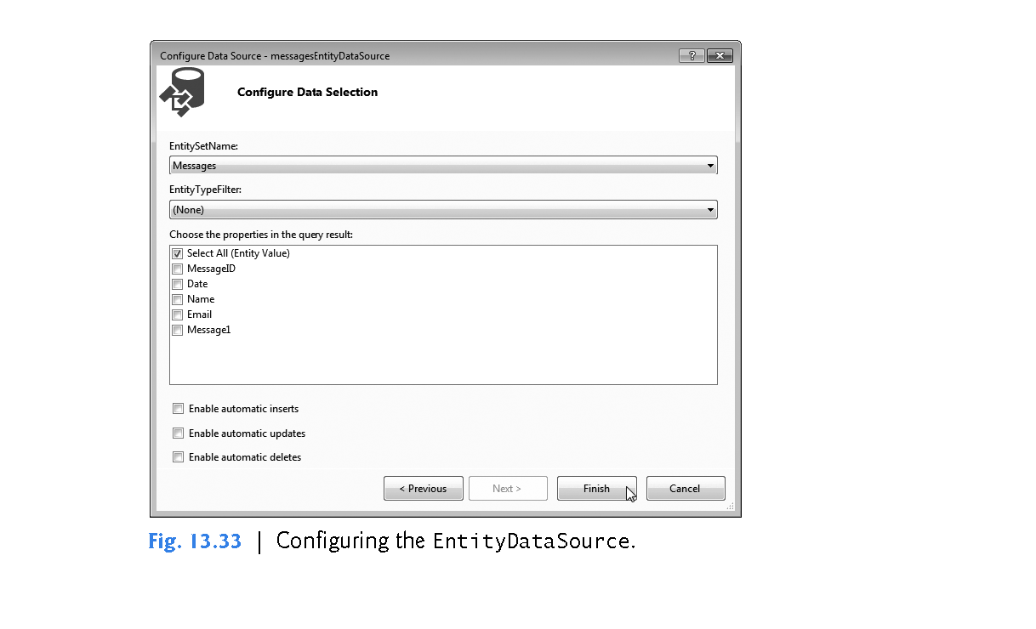

Slide 212
13.8.1 Building a Web Form that Displays Data from a Database (cont.)
Click Finish to complete the wizard. A control named messagesEntityDataSource now appears on the Web Form directly below the GridView.
It’s represented in Design mode as a gray box containing its type and name.
It will not appear on the web page—the gray box simply provides a way to manipulate the control visually through Design mode—similar to how the objects in the component tray are used in Design mode for a Windows Forms app.

Slide 213
13.8.1 Building a Web Form that Displays Data from a Database (cont.)
Click the messagesEntityDataSource, then select Refresh Schema from its smart-tag menu. The GridView updates to display column headers that correspond to the columns in the Messages table (Fig. 13.34).
The rows each contain either a number (which signifies an autoincremented column) or abc (which indicates string data).
The actual data from the Guestbook.mdf database file will appear in these rows when you view the ASPX file in a web browser.

Slide 214
13.8.1 Building a Web Form that Displays Data from a Database (cont.)
Step 6: Customizing the Columns of the Data Source Displayed in the GridView
It’s not necessary for site visitors to see the MessageID column when viewing past guestbook entries—this column is merely a unique primary key required by the Messages table within the database.
So, let’s modify the GridView to prevent this column from displaying on the Web Form.
We’ll also modify the column Message1 to read Message.
In the GridView Tasks smart tag menu, click Edit Columns to display the Fields dialog (Fig. 13.35).

Slide 215


Slide 216


Slide 217
13.8.1 Building a Web Form that Displays Data from a Database (cont.)
Select MessageID in the Selected fields pane, then click the Button. This removes the MessageID column from the GridView.
Select Message1 in the Selected fields pane and change its HeaderText property to Message. The IDE renamed this field to prevent a naming conflict in the entity data model classes. Click OK to return to the main IDE window.

Slide 218
13.8.1 Building a Web Form that Displays Data from a Database (cont.)
Next create a style to specify the width of the GridView. Select FORMAT > New Style… to display the New Style dialog. In the Selector field, specify .gridViewWidth as the new style’s name. Select the Category named Position, then set the width: to 650px and click OK to create the style and dismiss the dialog. Next set the CssClass property for the messagesGridView to gridViewWidth.
The GridView should now appear as shown in Fig. 13.31.

Slide 219
13.8.2 Modifying the Code-Behind File for the Guestbook App
After building the Web Form and configuring the data controls used in this example, double click the Submit and Clear buttons in Design view to create their corresponding Click event handlers in the code-behind file (Fig. 13.36).
The IDE generates empty event handlers, so we must add the appropriate code to make these buttons work properly.
The event handler for clearButton (lines 38–43) clears each TextBox by setting its Text property to an empty string.
This resets the form for a new guestbook submission.

Slide 220


Slide 221


Slide 222
13.8.3 Modifying the Code-Behind File for the Guestbook App (cont.)
Lines 8–35 contain submitButton’s event-handling code, which adds the user’s information to the Guestbook database’s Messages table.
The Using statement in lines 12–26 begins by creating a GuestbookEntities object to interact with the database.
Recall that the Using statement will call Dispose on this GuestbookEntities object when the Using statement terminates.

Slide 223
13.8.3 Modifying the Code-Behind File for the Guestbook App (cont.)
Line 15 creates an object of the entity data model’s Message class, which represents a row in the database’s Messages table.
Lines 18–21 set the new Message object’s properties to the values that should be stored in the database.
Line 24 calls the Add method of the GuestbookEntities object’s Messages property, which represents the Messages table in the database.
This adds a new record to the entity data model’s representation of the table.
Line 25 then saves the changes into the database.

Slide 224
13.8.3 Modifying the Code-Behind File for the Guestbook App (cont.)
After the data is inserted into the database, lines 29–31 clear the TextBoxes, and line 34 invokes messagesGridView’s DataBind method to refresh the data that the GridView displays.
This causes messagesEntityDataSource (the GridView’s data source) to obtain the Messages table’s updated data from the database.

Slide 225
13.9 Online Case Study: ASP.NET AJAX
In the online Chapter 24, Web App Development with ASP.NET: A Deeper Look, you learn the difference between a traditional web app and an AJAX (Asynchronous JavaScript and XML) web application.
You also learn how to use ASP.NET AJAX to quickly and easily improve the user experience for your web apps, giving them responsiveness comparable to that of desktop apps.
To demonstrate ASP.NET AJAX capabilities, you enhance the validation example by displaying the submitted form information without reloading the entire page.
The only modifications to this web app appear in Validation.aspx file.
You use AJAX-enabled controls to add this feature.

Slide 226
13.10 Online Case Study: Password-Protected Books Database App
In the online Chapter 24, Web App Development with ASP.NET: A Deeper Look, we include a web app case study in which a user logs into a password-protected website to view a list of publications by a selected author.
The app consists of several pages and provides website registration and login capabilities.
You’ll learn about ASP.NET master pages, which allow you to specify a common look-and-feel for all the pages in your app.
We also introduce the Web Site Administration Tool and use it to configure the portions of the app that can be accessed only by users who are logged into the website.

